Slide 1

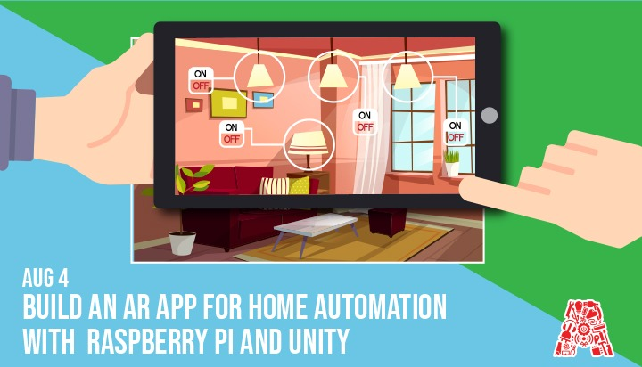
Wifi - In5-Tech [Code - WelcomeToIn5]

Slide 2
About the Assembly
A smart lab based out of In5 since Dec 2014
Over 200 free workshops done
ASSEMBLY: HACK - Embedded systems, iOT and hardware
ASSEMBLY: CODE - Software projects - APIs, frameworks, apps
Age range: 16-60 - students, professionals, entrepreneurs
Focus on smart technology and practical applications
Forum: members.theassembly.ae

Slide 3
TAG US ON SOCIAL MEDIA!
FACEBOOK - The Assembly (@MakeSmartThings)
TWITTER - @MakeSmartThings
INSTAGRAM - @MakeSmartThings
YOUTUBE - The Assembly

Slide 4

Dependencies
The following must be installed on your machine:
Unity3D
Vuforia
Code Editor
VNC viewer
Android Studio / Android SDK (optional)

Slide 5
Overview
TOPICS:
Introduction Unity and Augmented Reality
Getting Started with Unity
Preparing the Scene
Adding the Code
Final Touches
Running

Slide 6
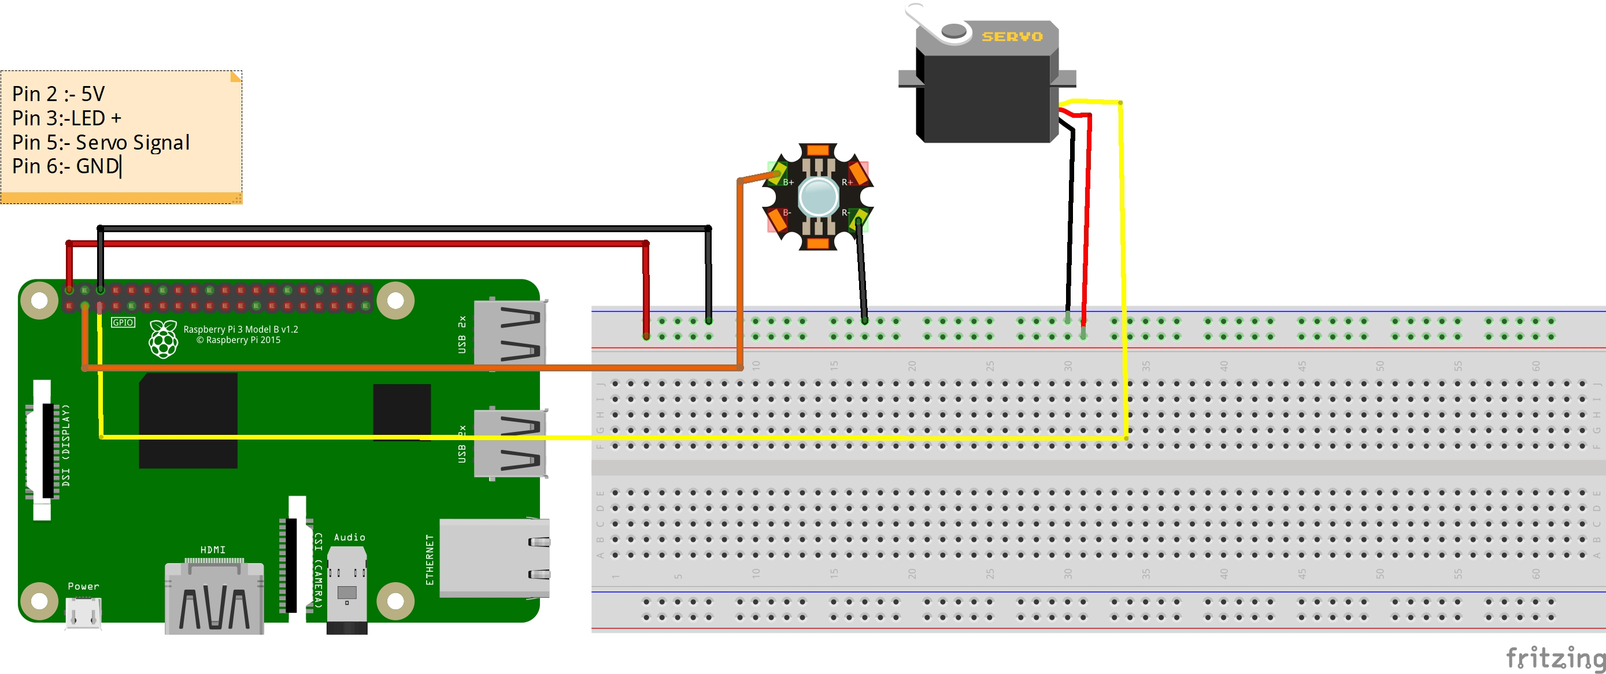

Slide 7


Introduction to Unity and Augmented Reality
Unity, what is it?
Augmented Reality, what is it?
AR within Unity

Slide 8
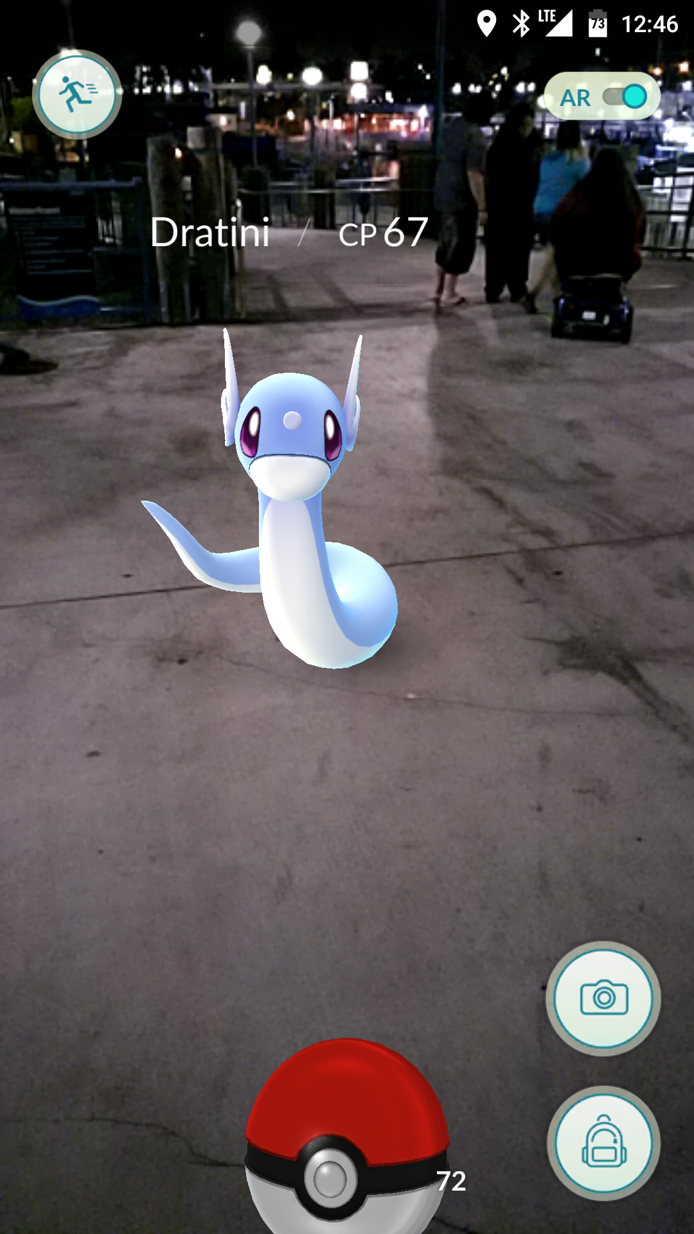
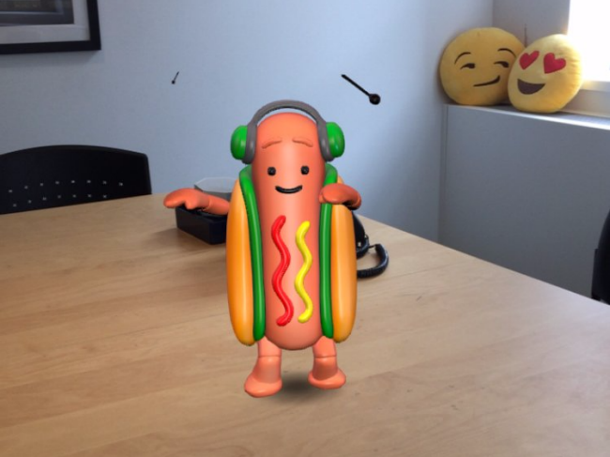
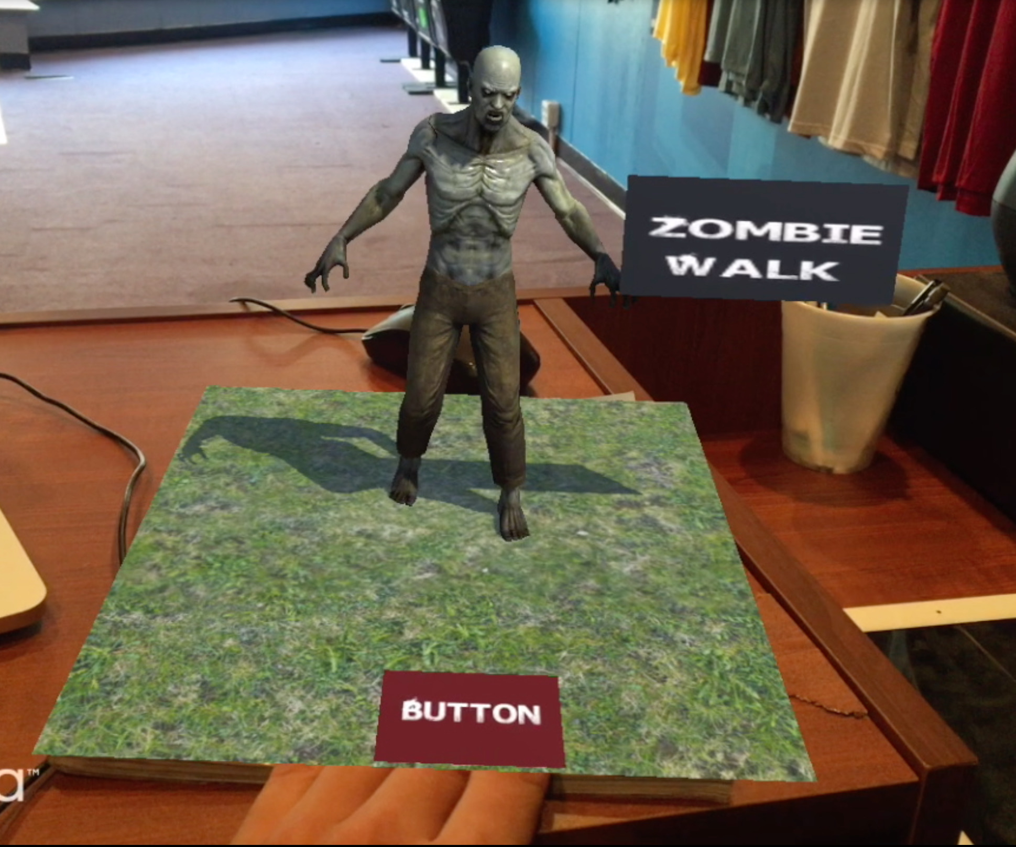

Slide 9
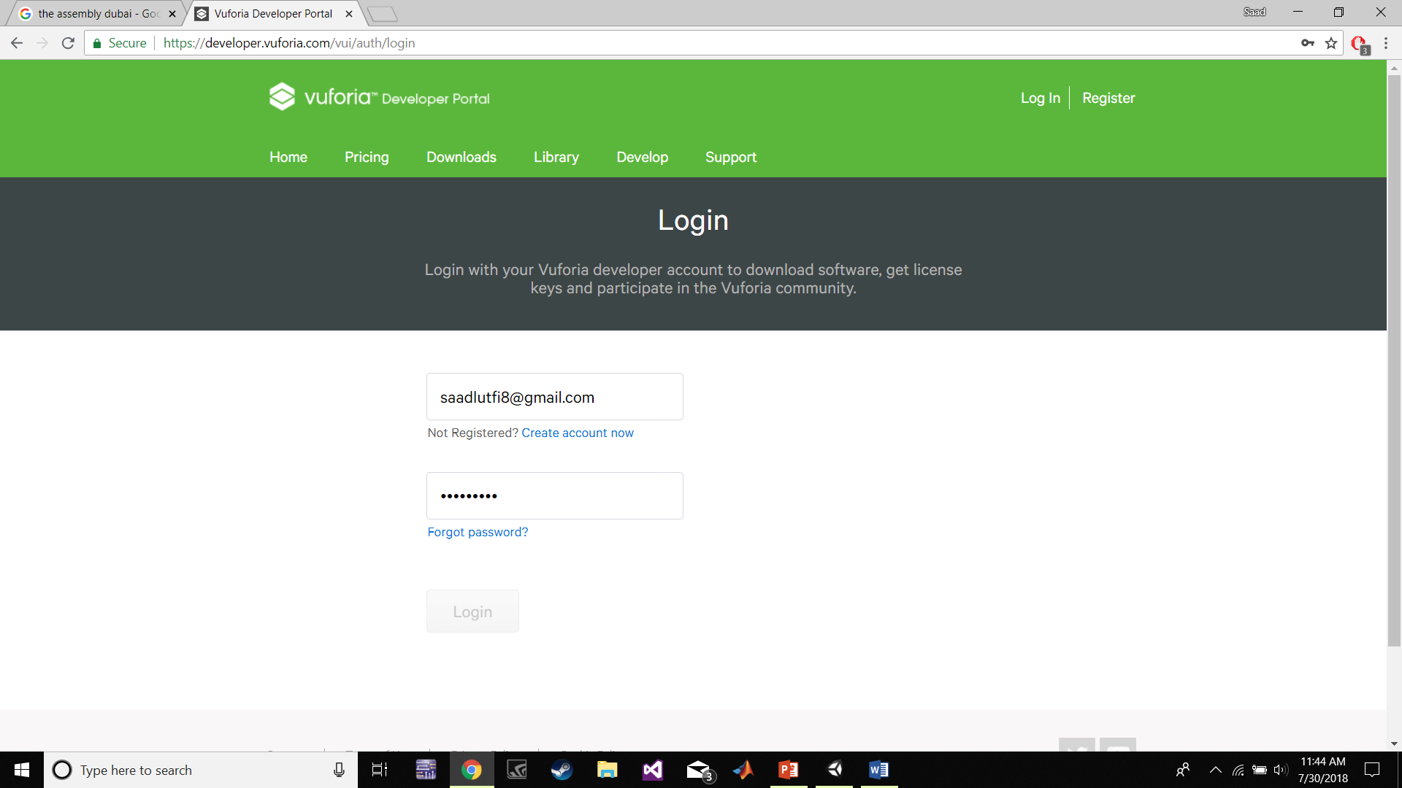
Getting Started

Slide 10
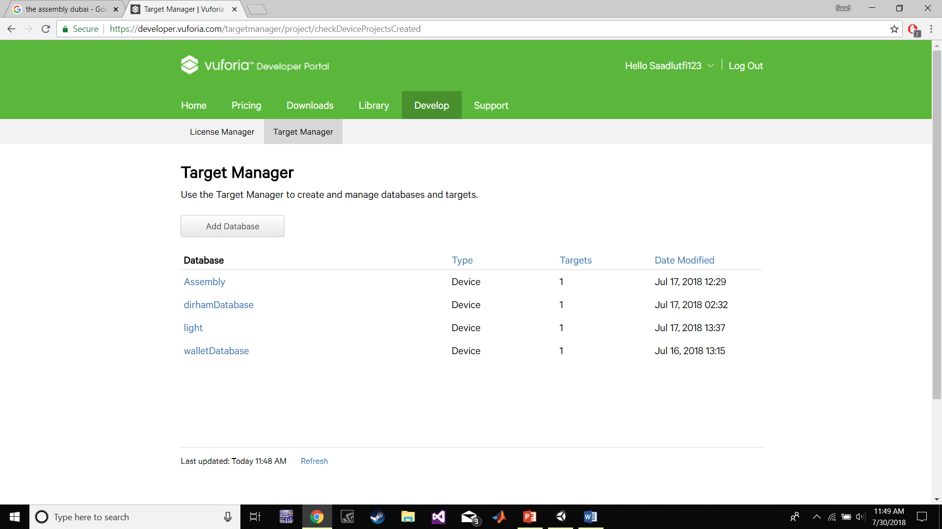
Getting Started

Slide 11
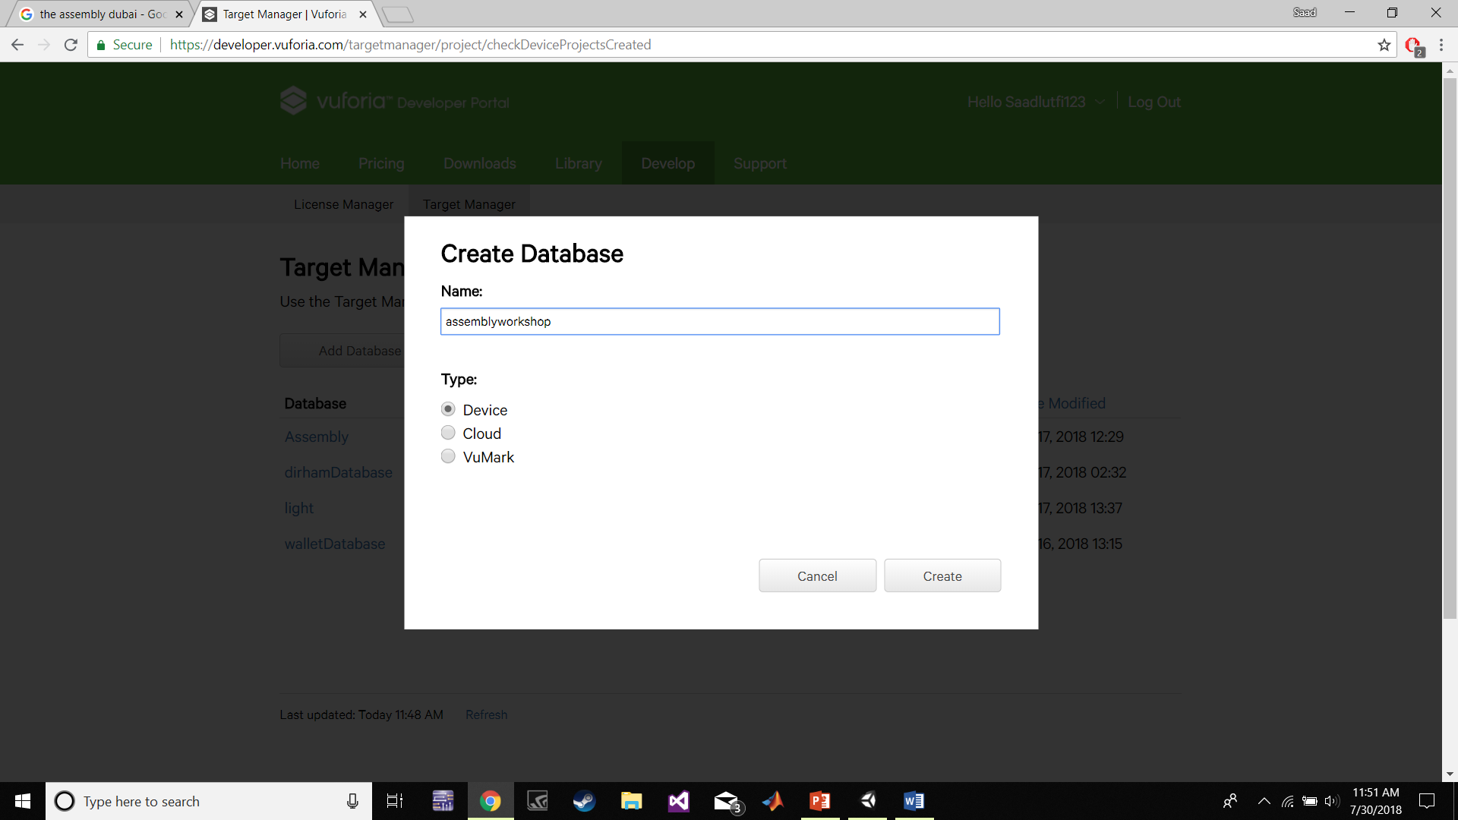
Getting Started

Slide 12
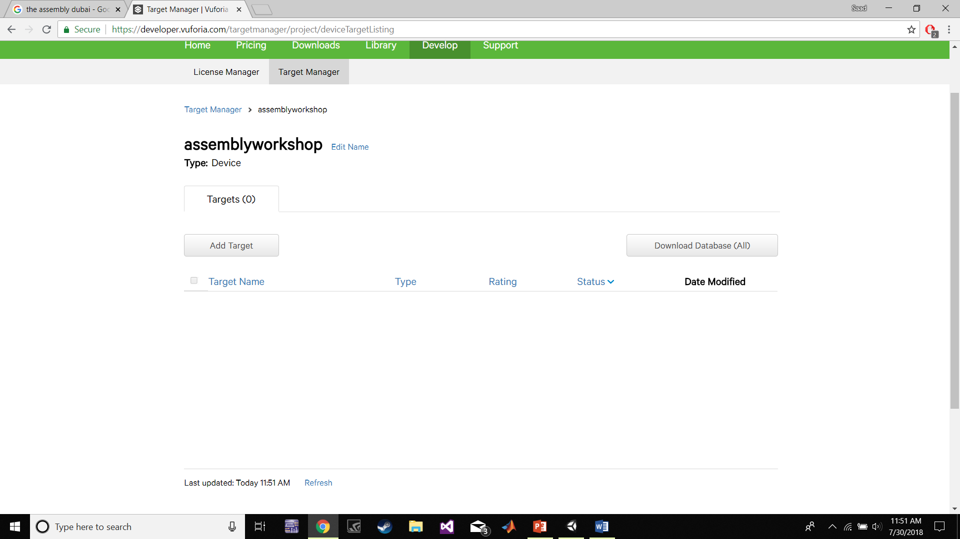
Getting Started

Slide 13
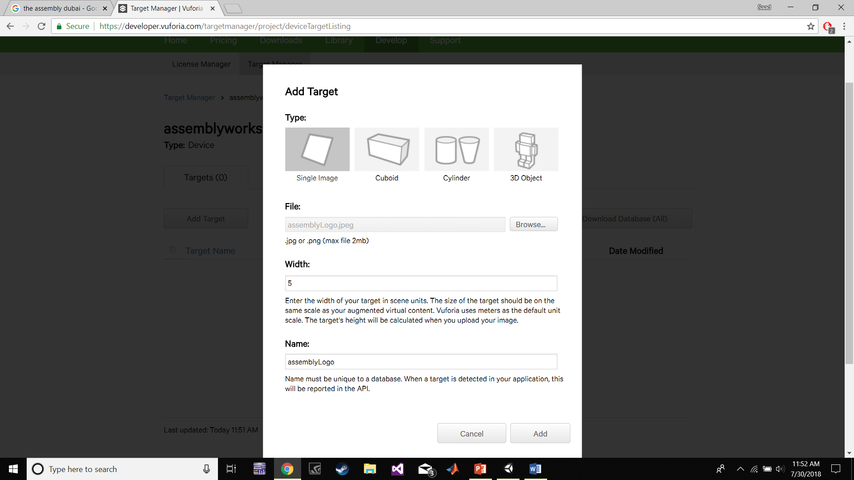
Getting Started

Slide 14
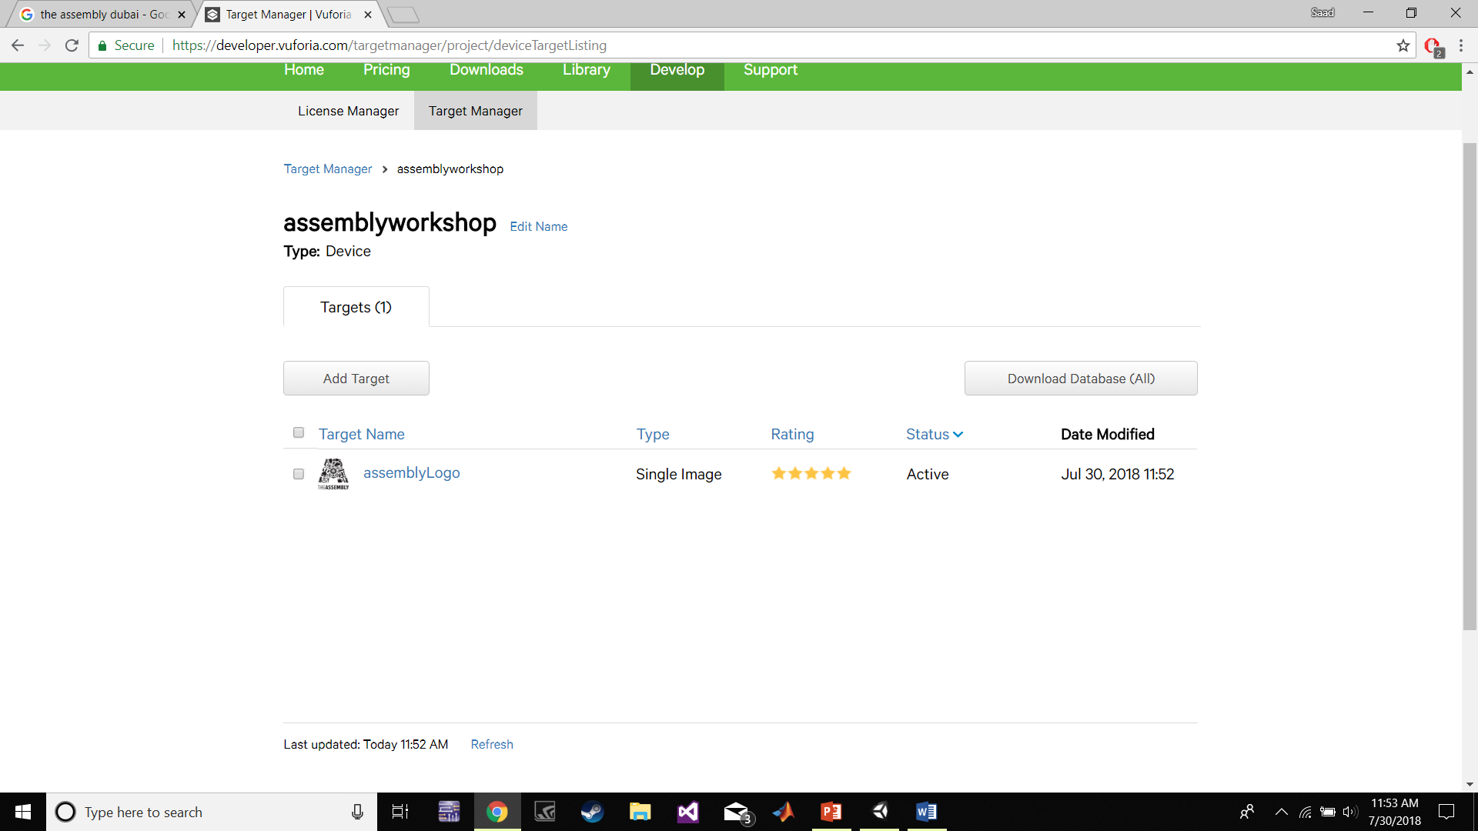
Getting Started

Slide 15
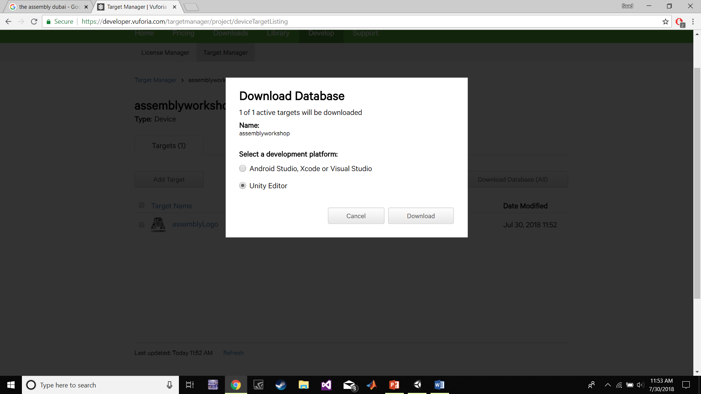
Getting Started

Slide 16
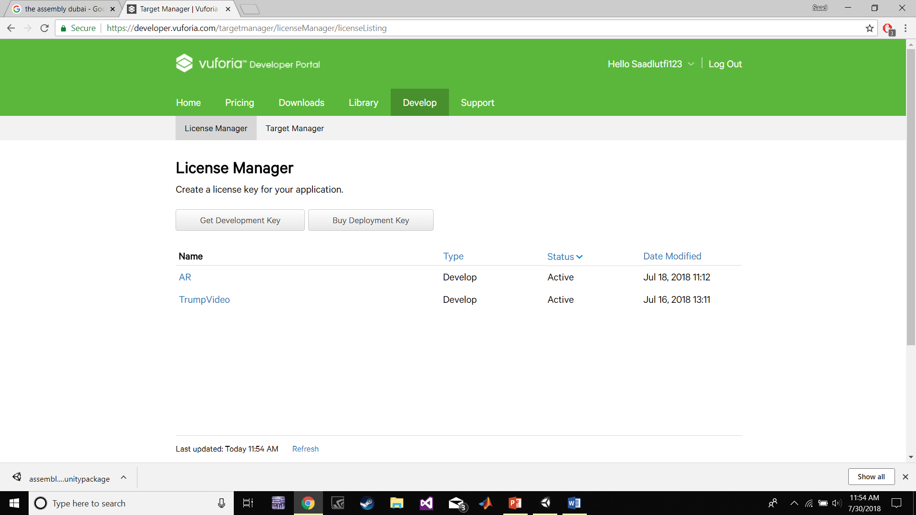
Getting Started

Slide 17
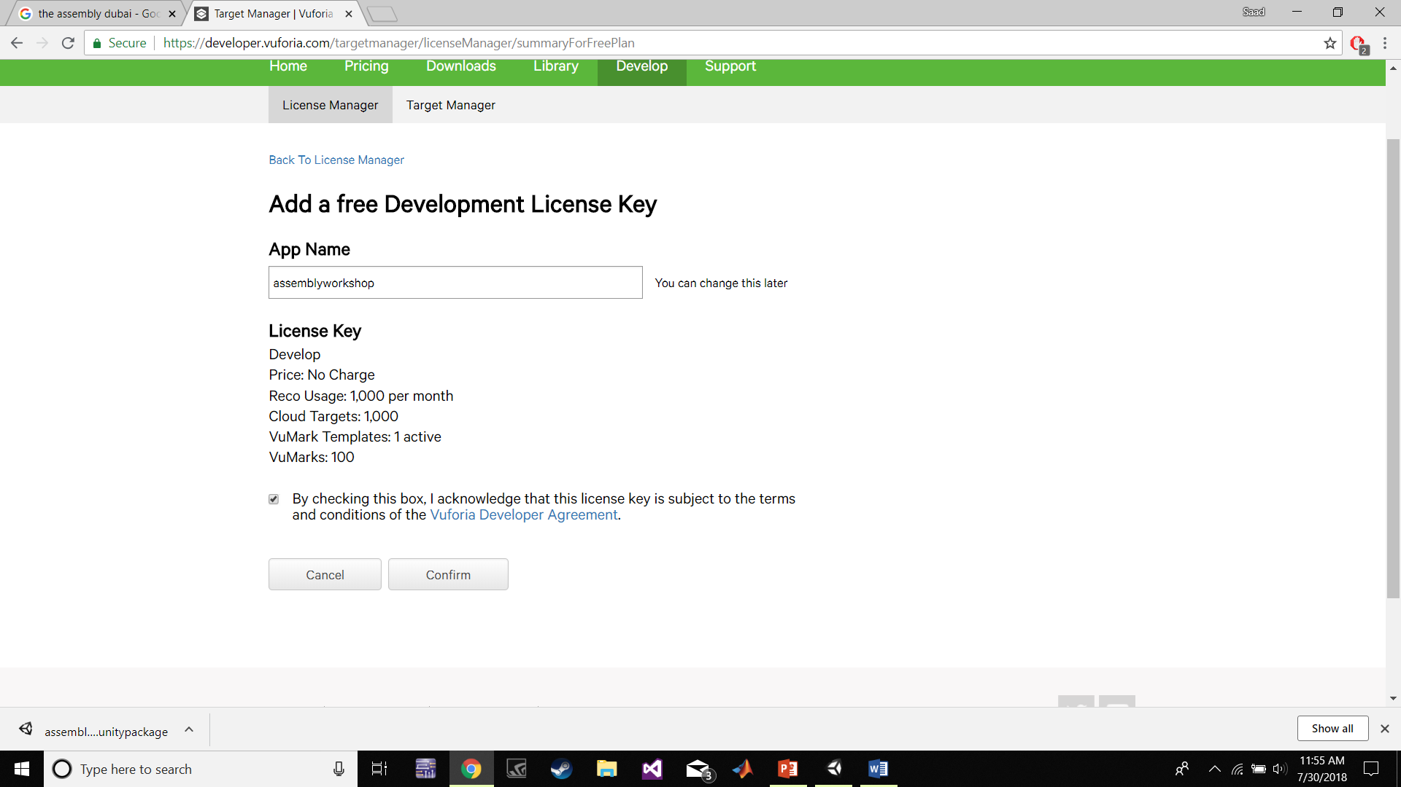
Getting Started

Slide 18
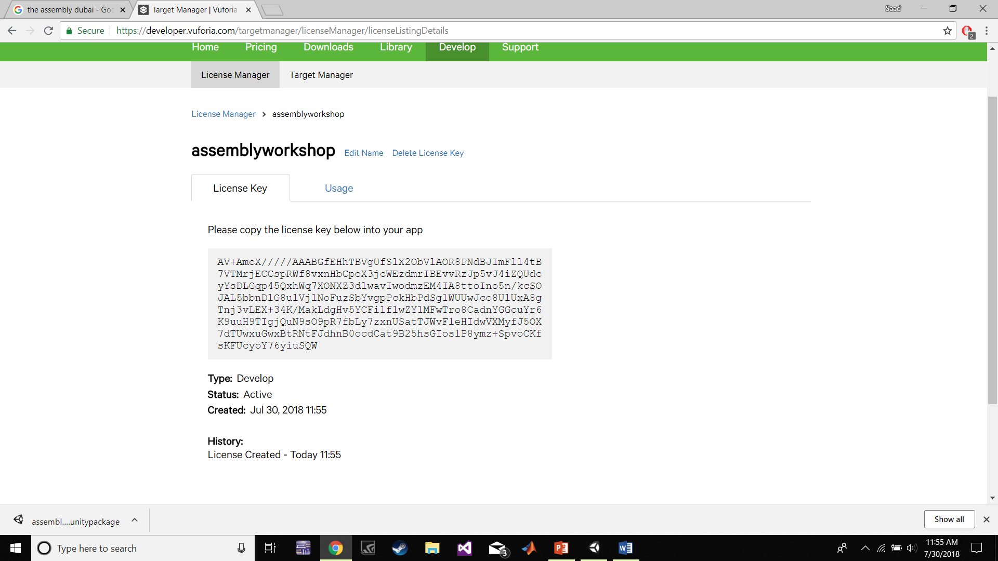
Getting Started

Slide 19
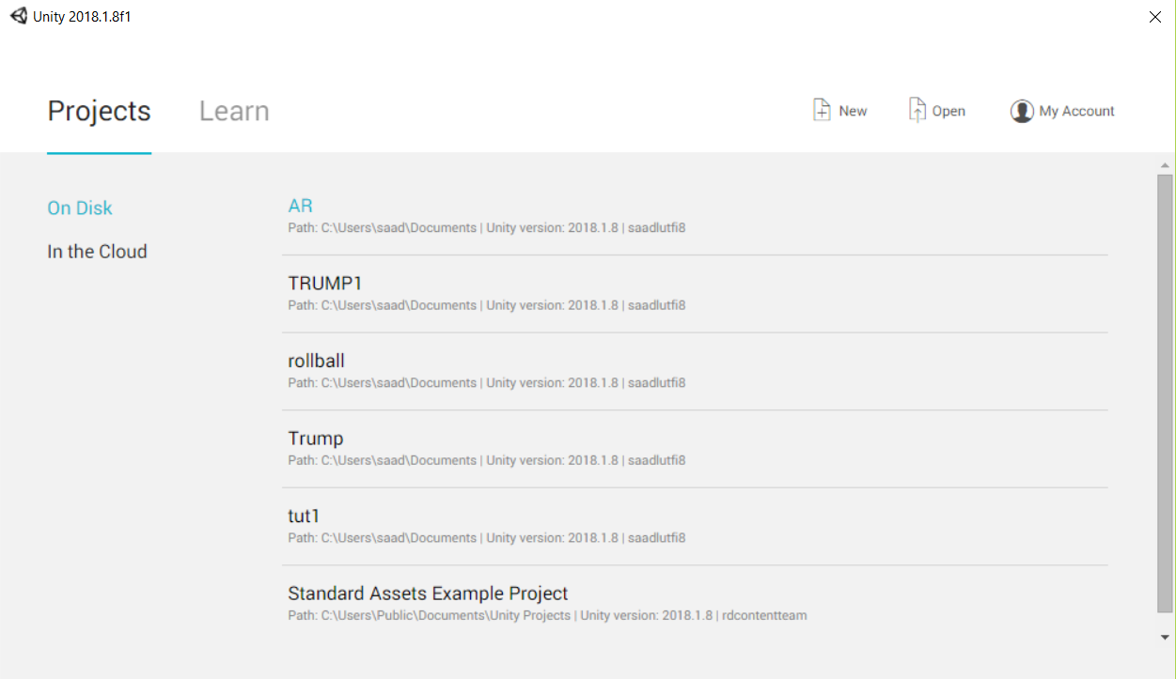
Getting Started

Slide 20
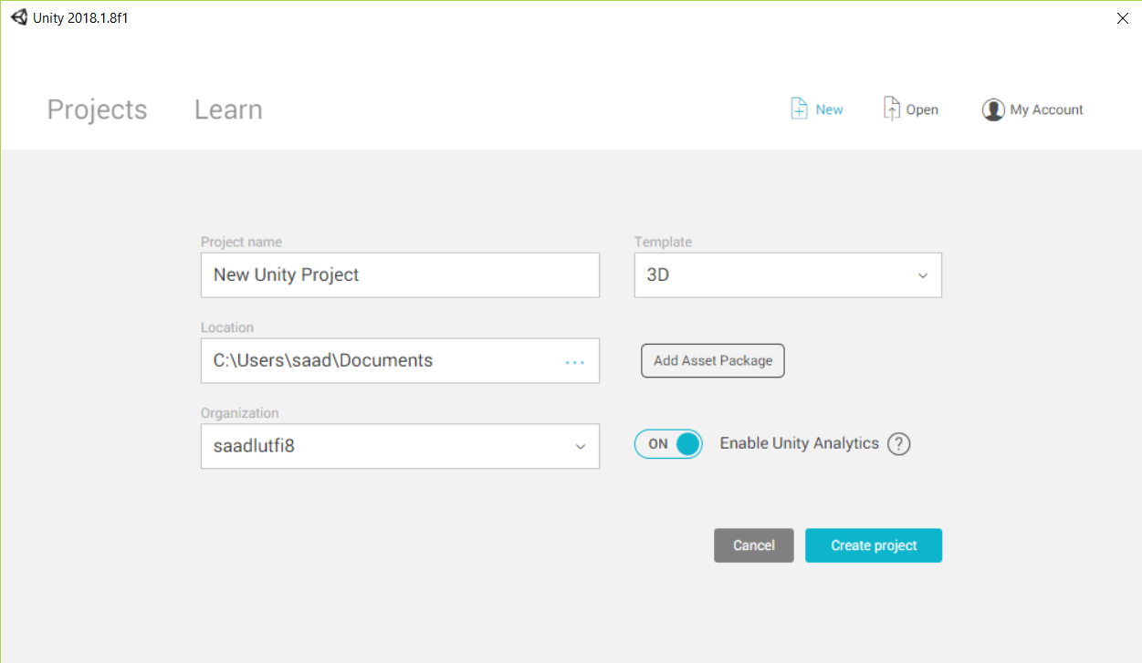
Getting Started

Slide 21
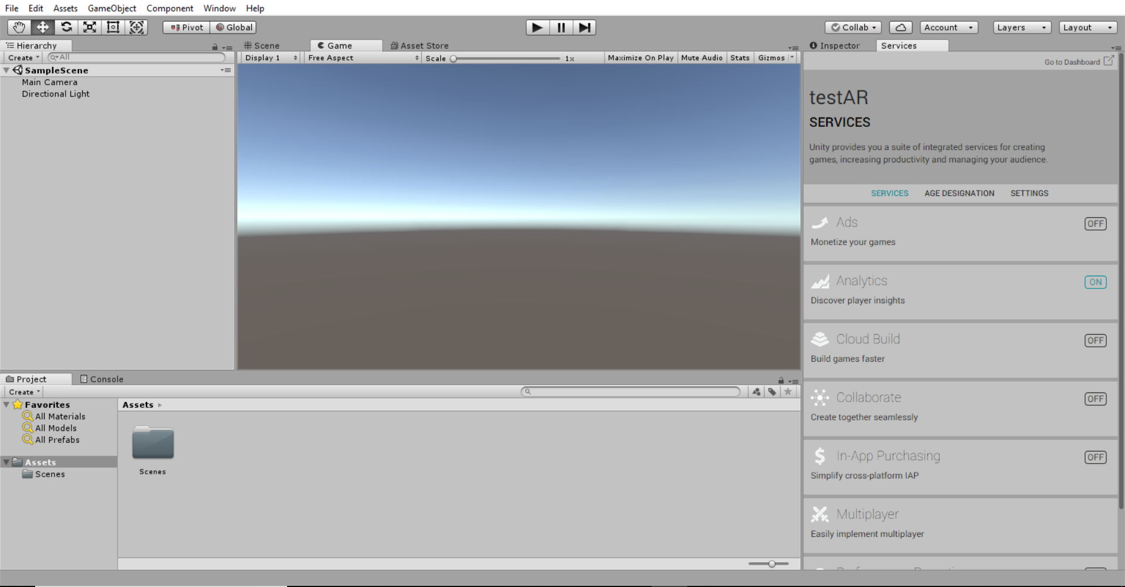
Getting Started

Slide 22
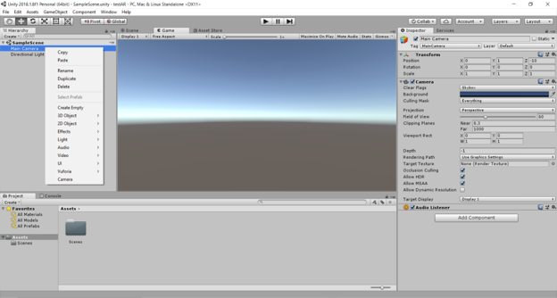
Preparing the Scene

Slide 23
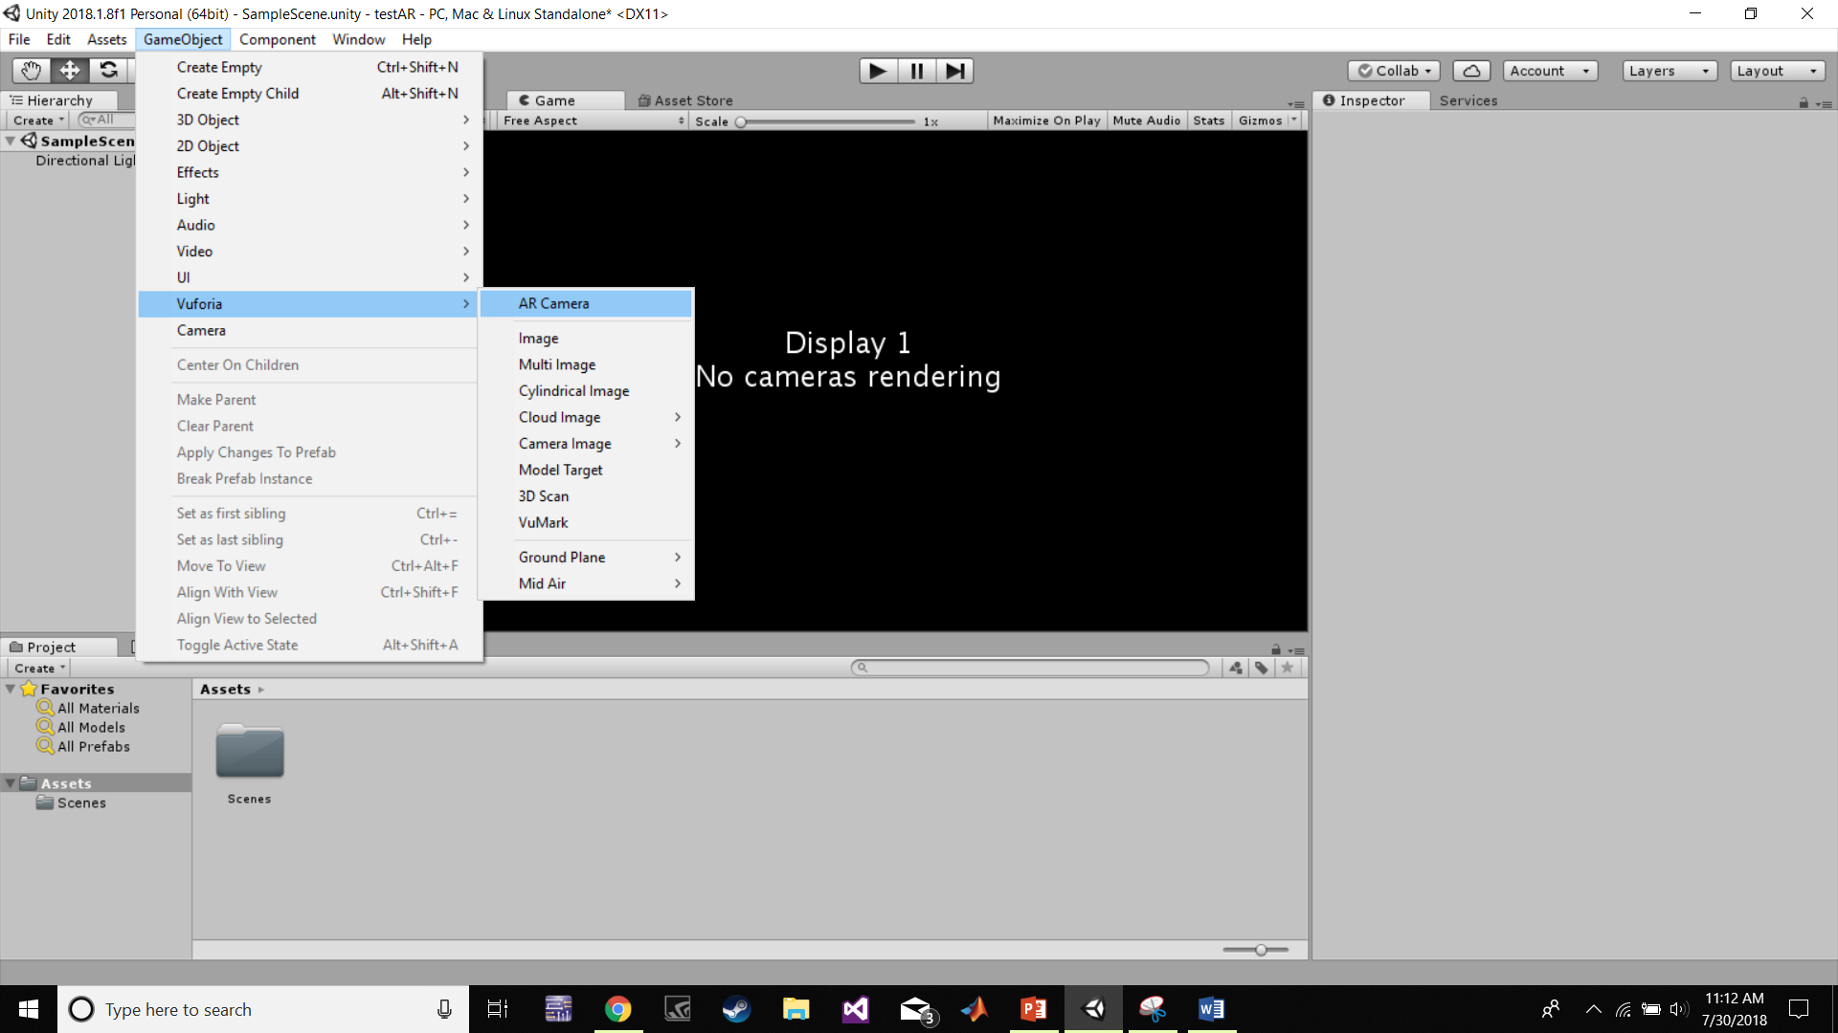
Preparing the Scene

Slide 24
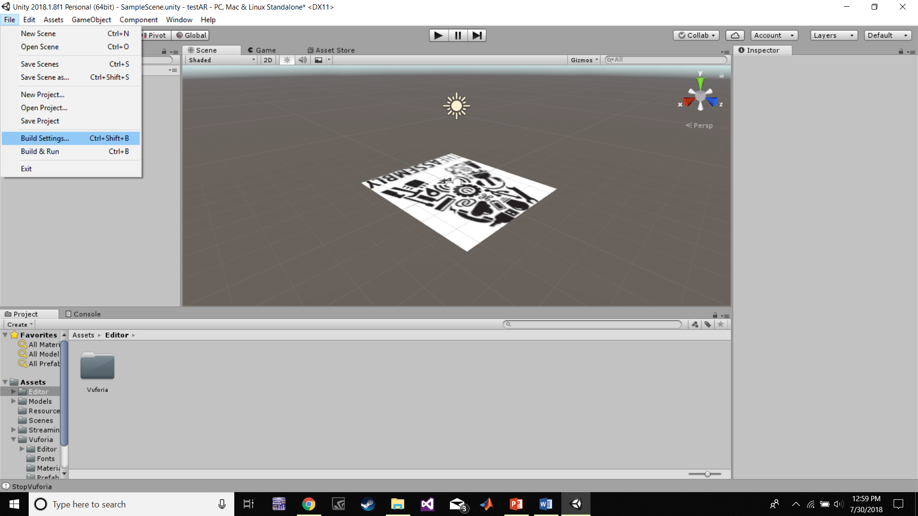
Preparing the Scene

Slide 25
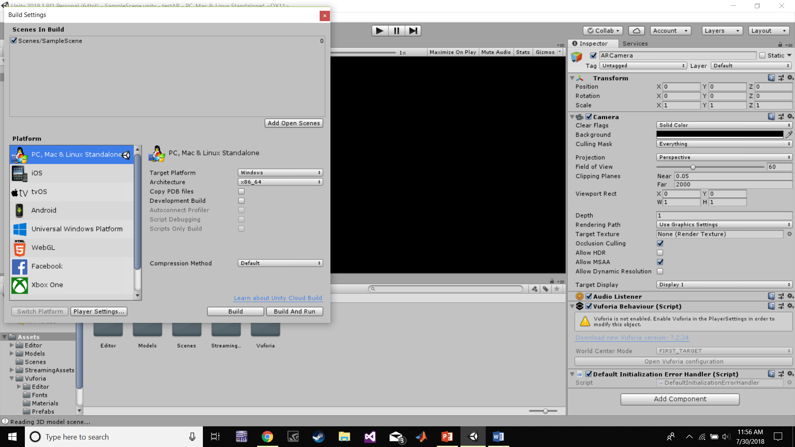
Preparing the Scene

Slide 26
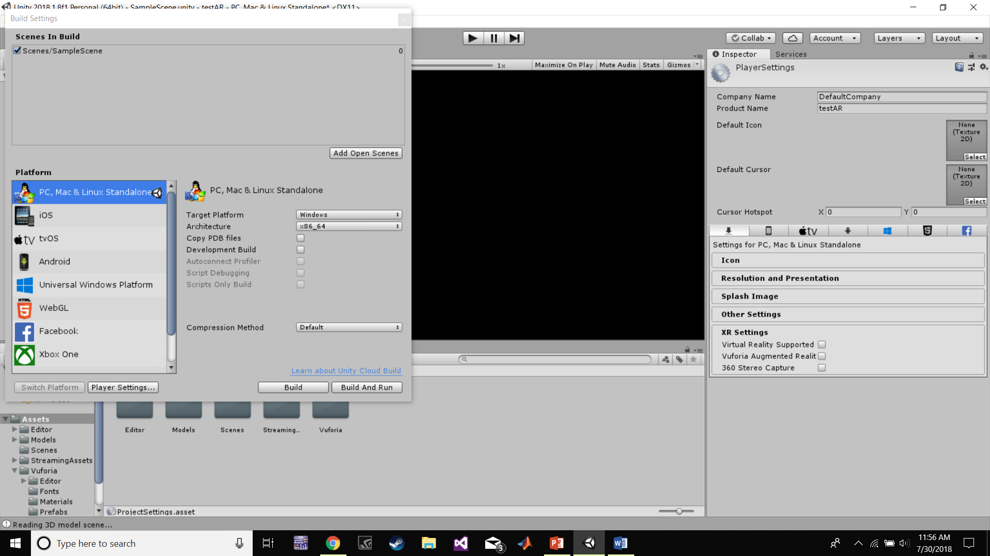
Preparing the Scene

Slide 27
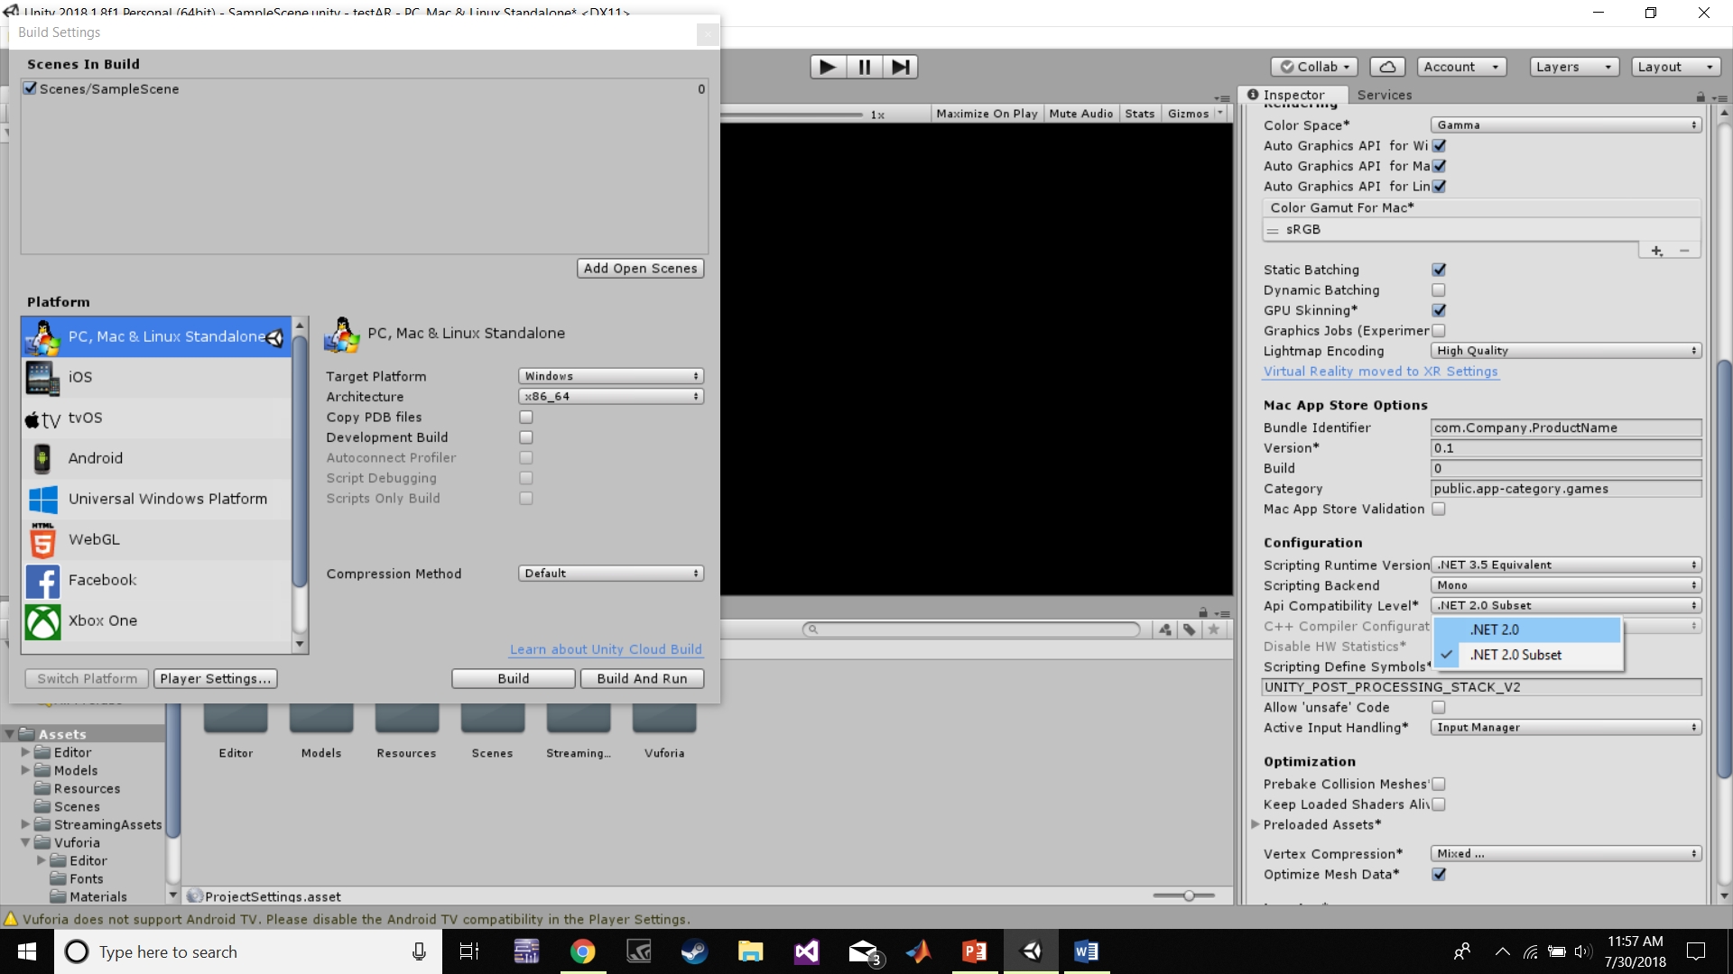
Preparing the Scene

Slide 28
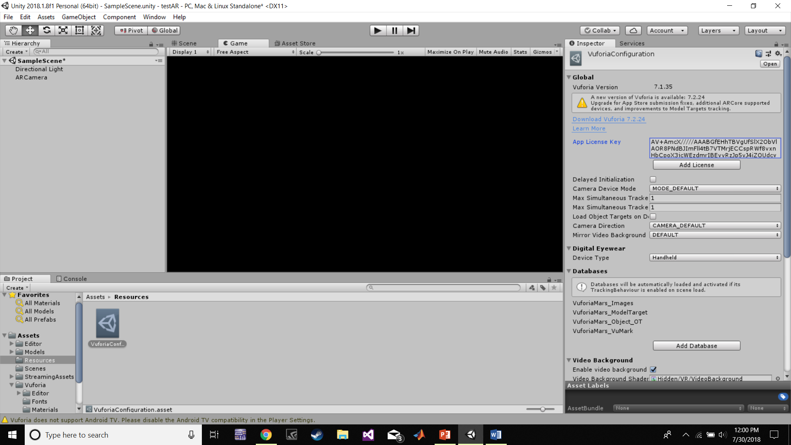
Preparing the Scene

Slide 29
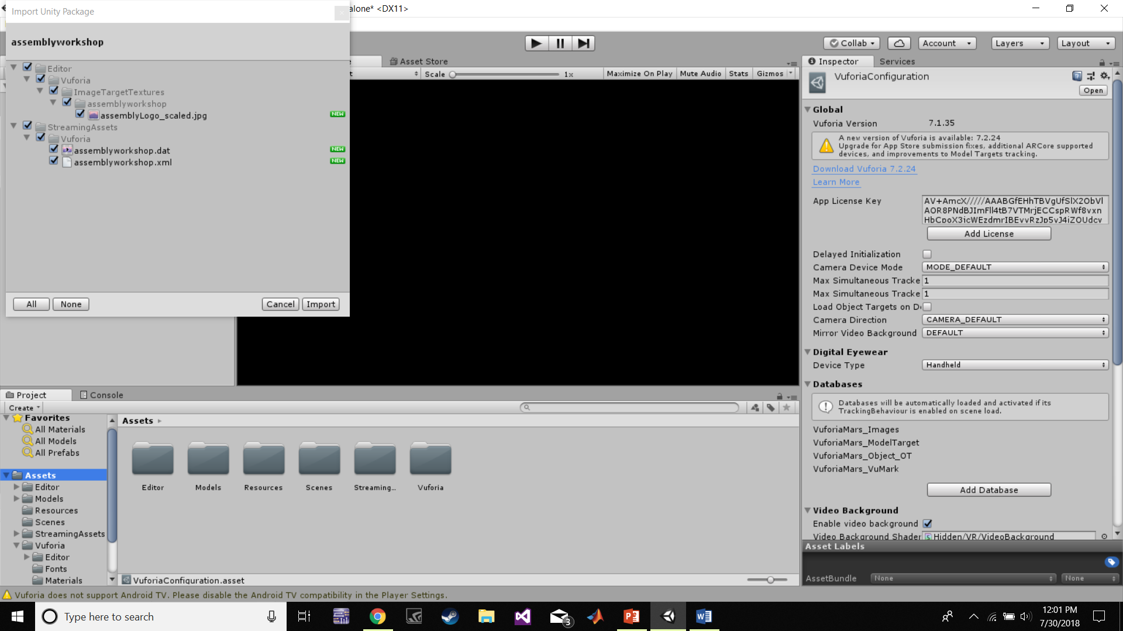
Preparing the Scene

Slide 30
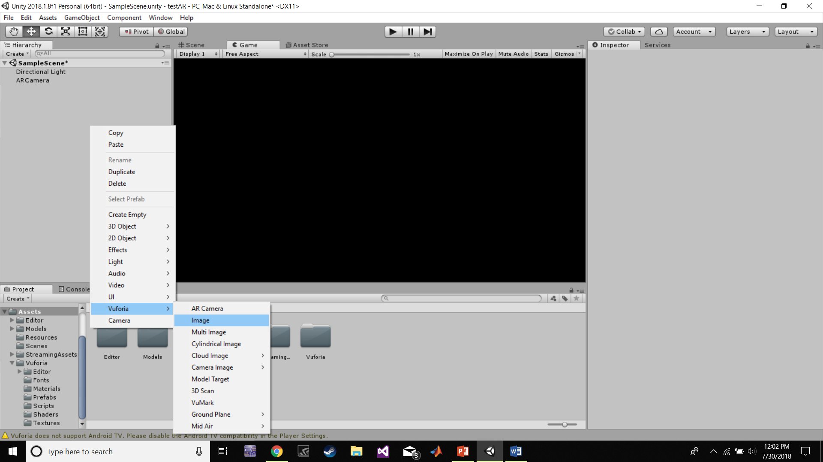
Preparing the Scene

Slide 31
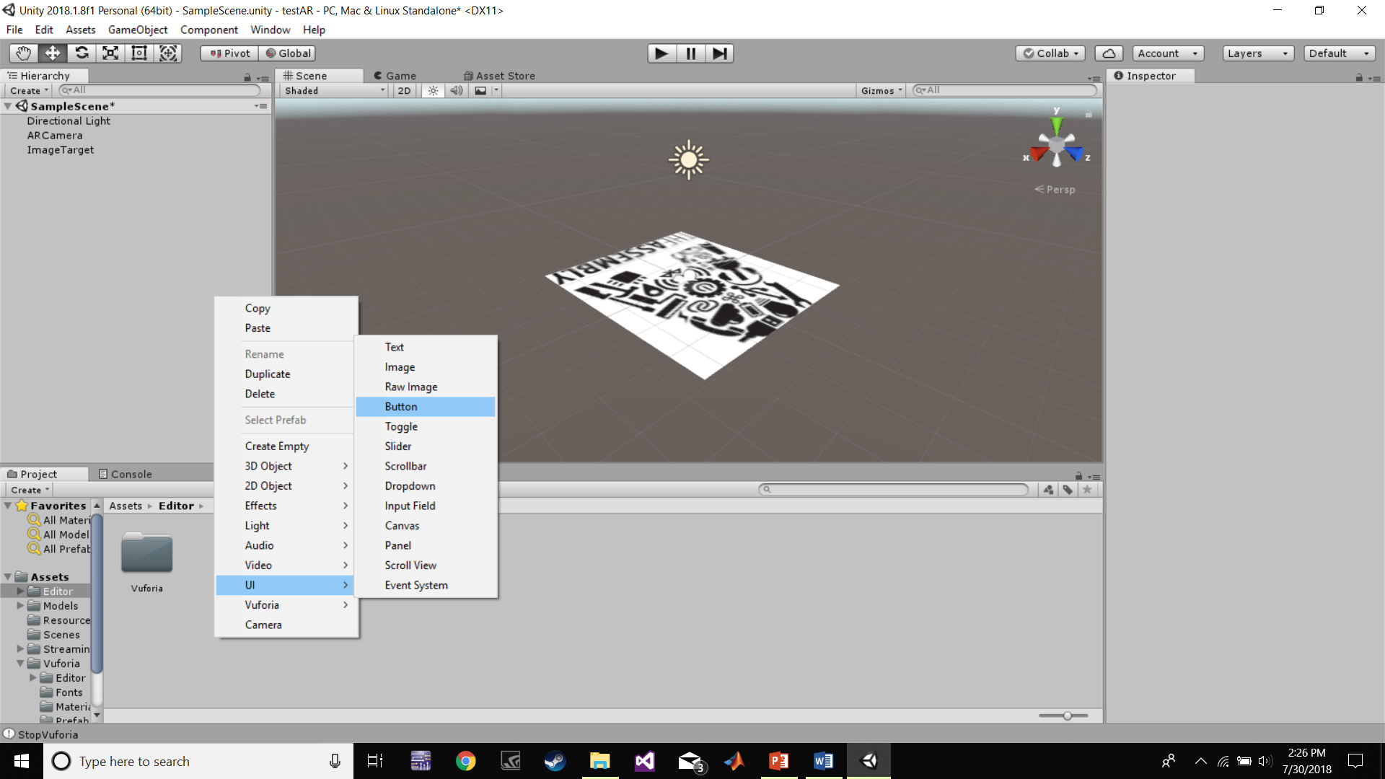
Preparing the Scene

Slide 32
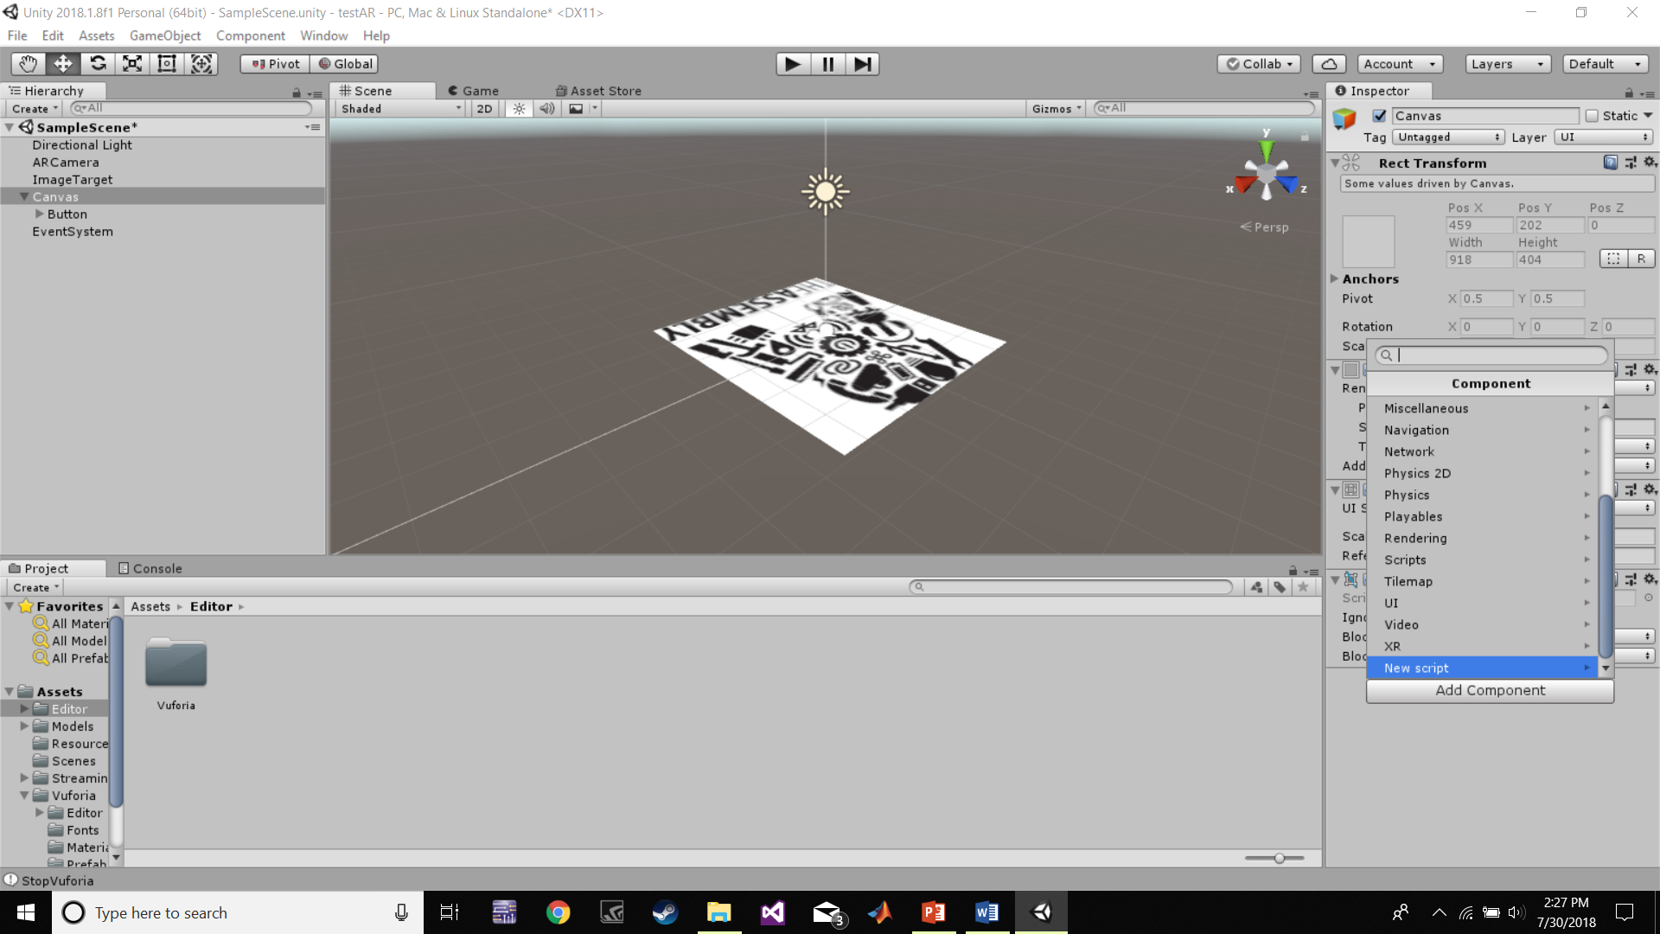
Preparing the Scene

Slide 33
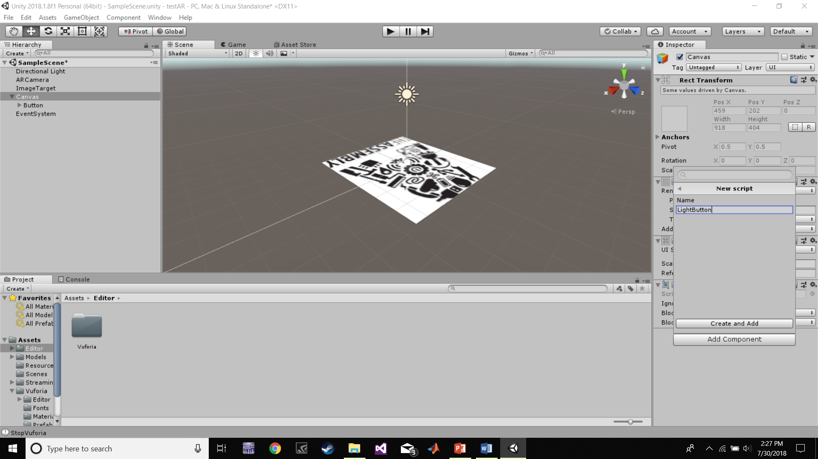
Preparing the Scene

Slide 34
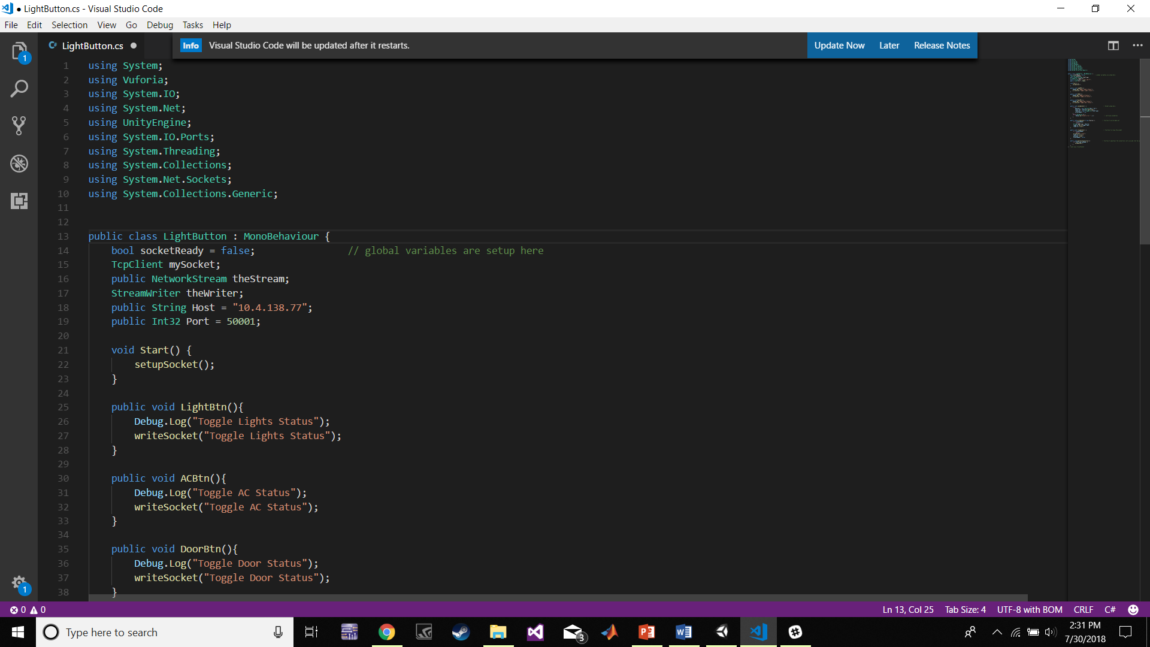
Adding the Code

Slide 35
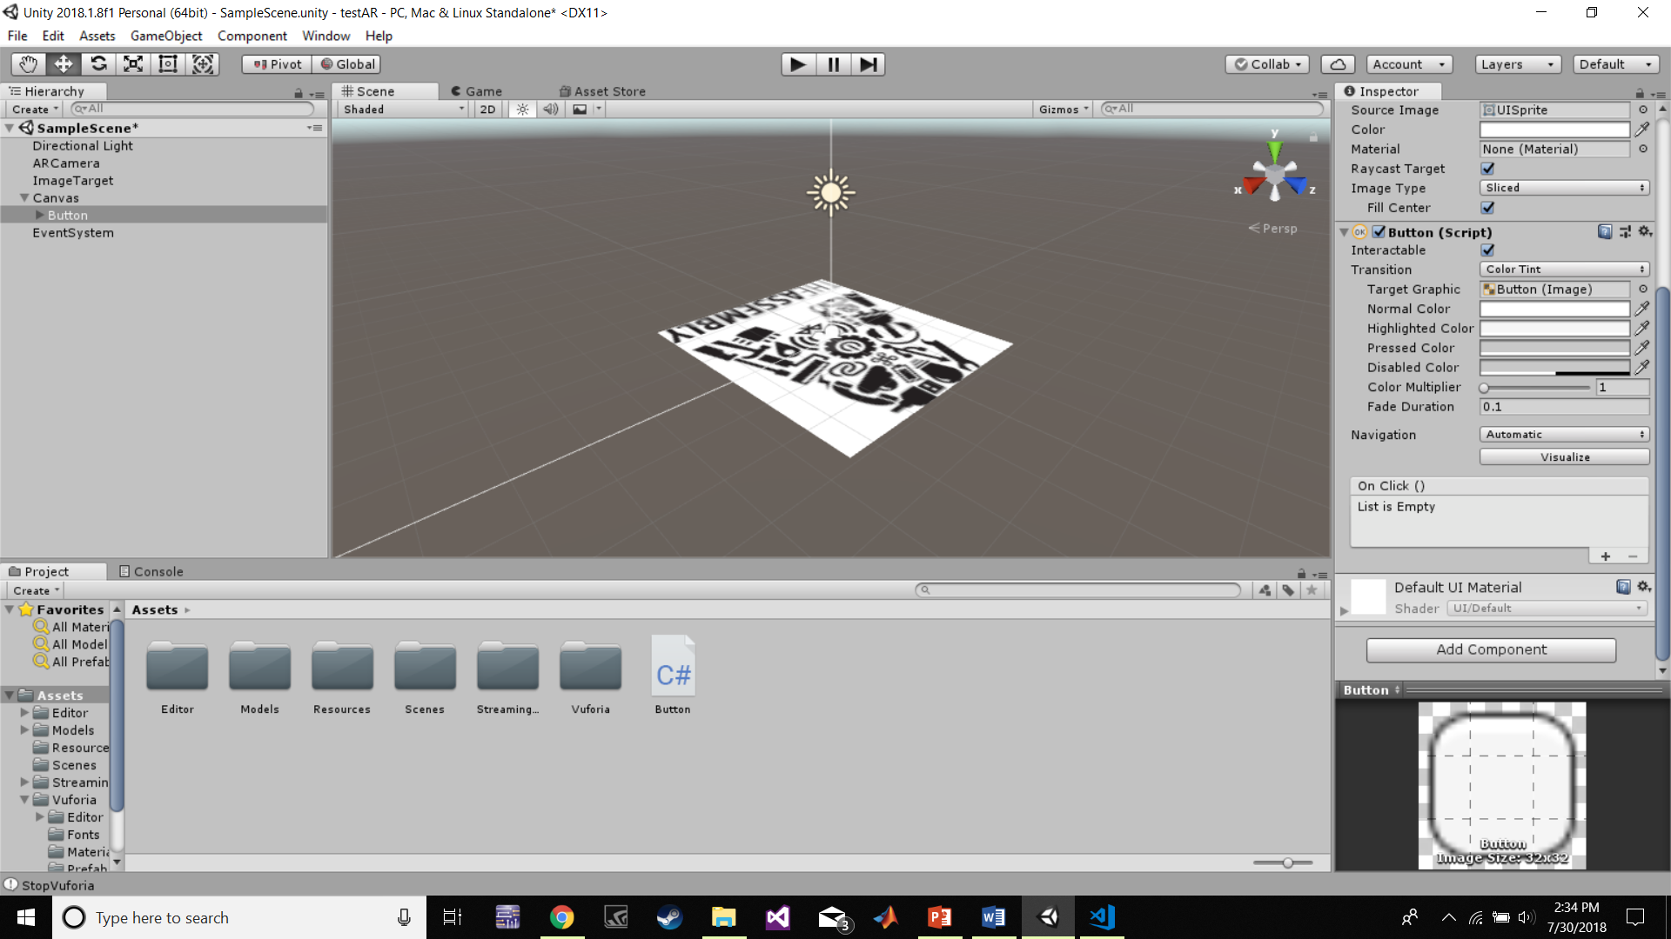
Final Touches

Slide 36
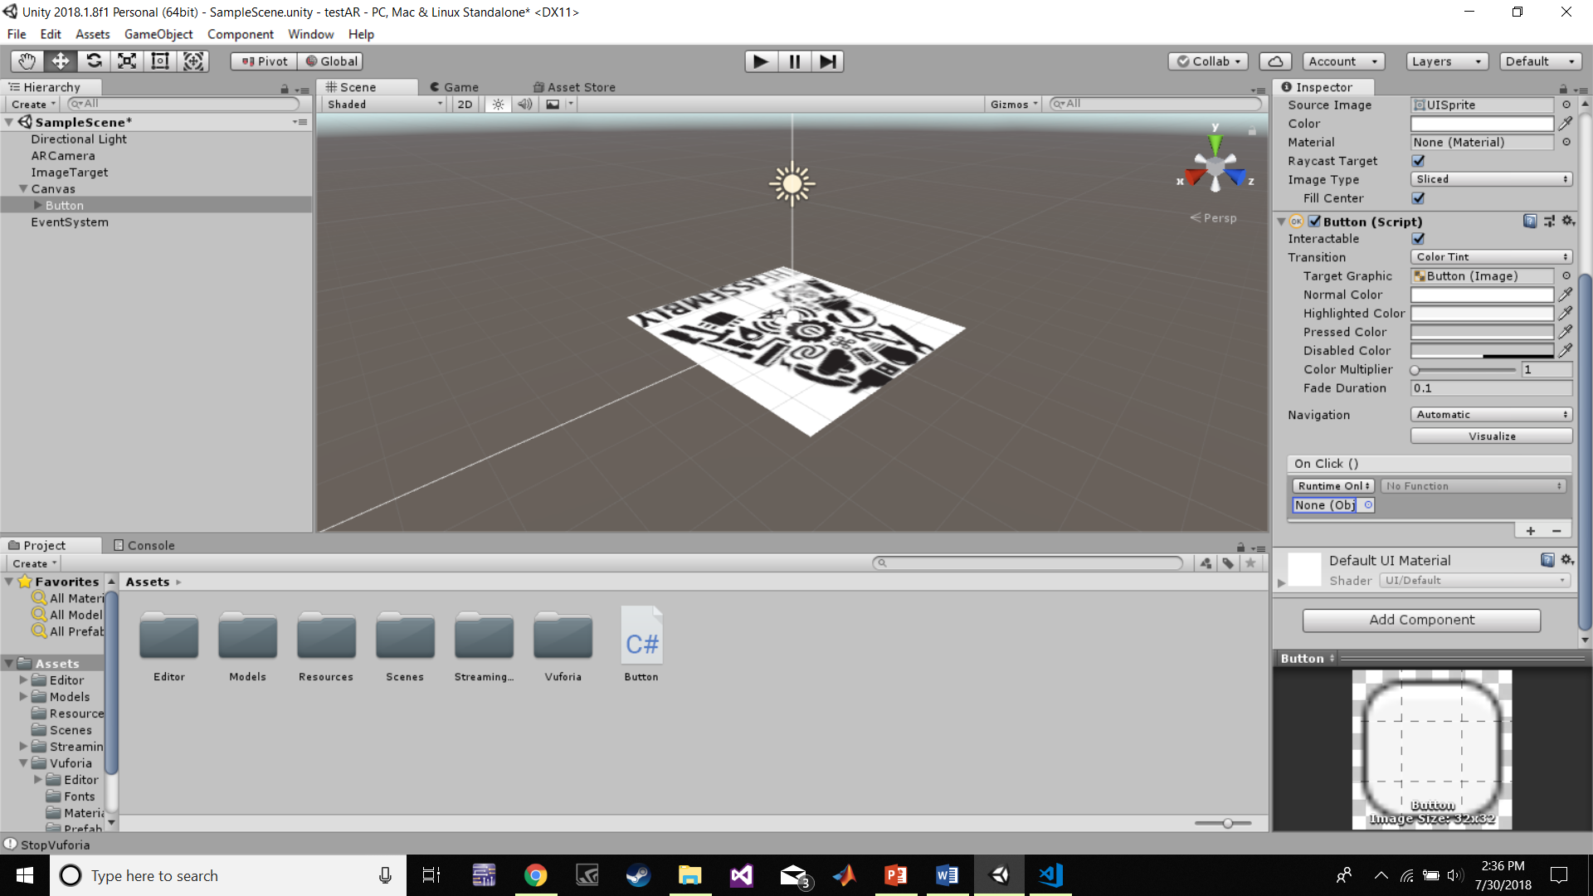
Final Touches

Slide 37
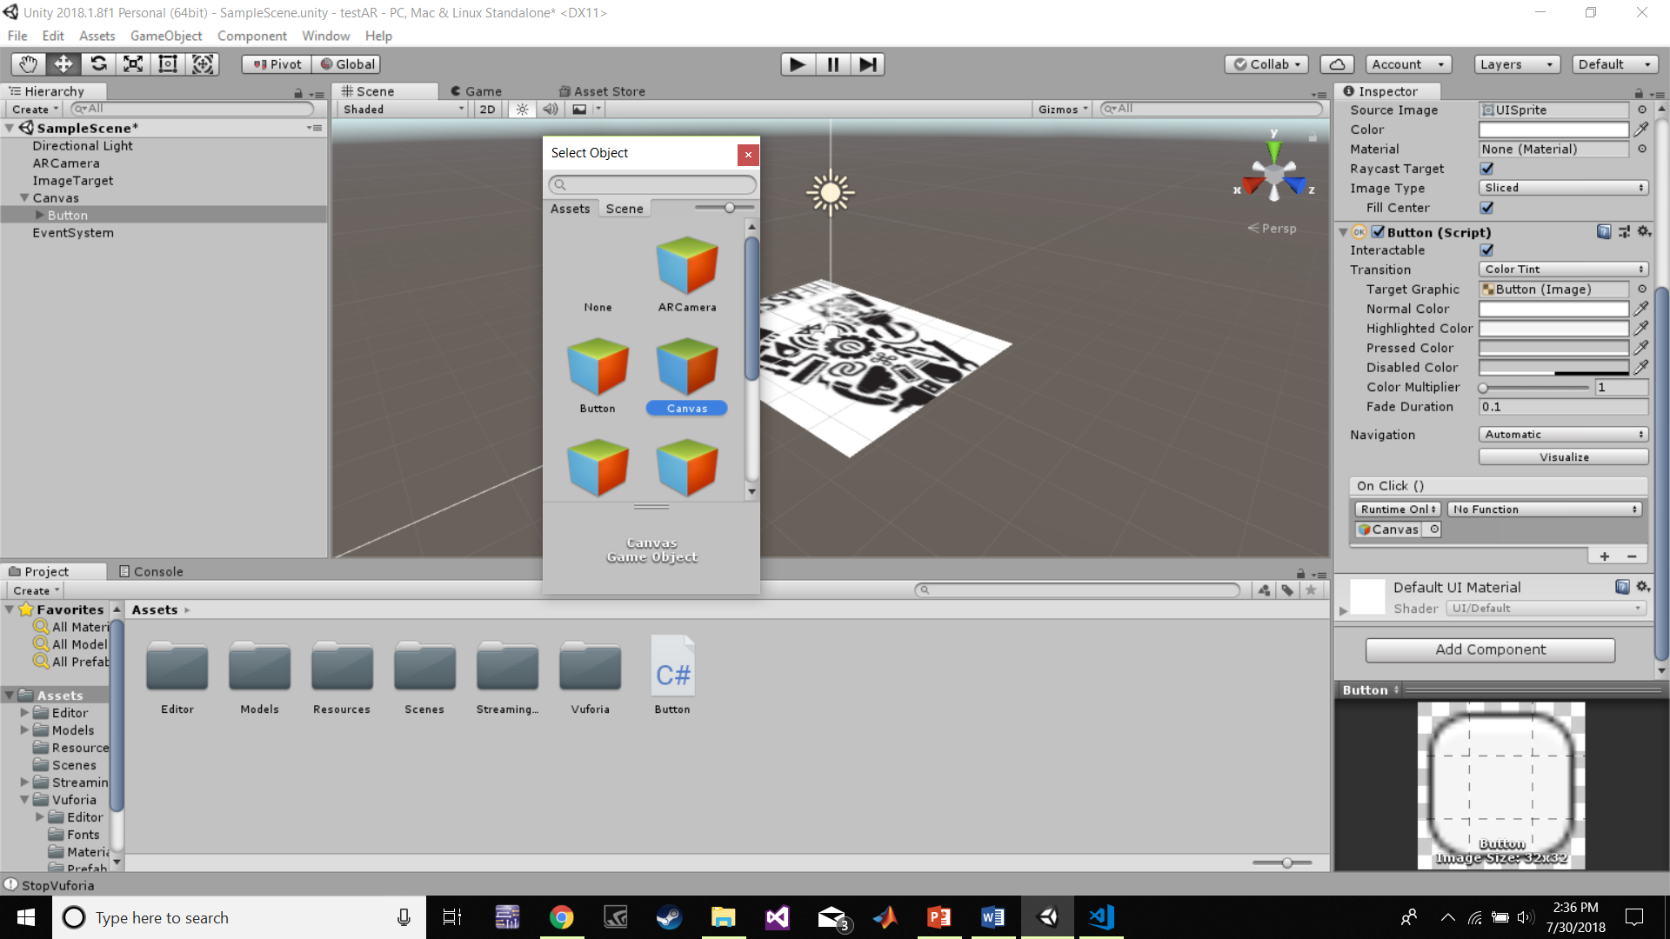
Final Touches

Slide 38
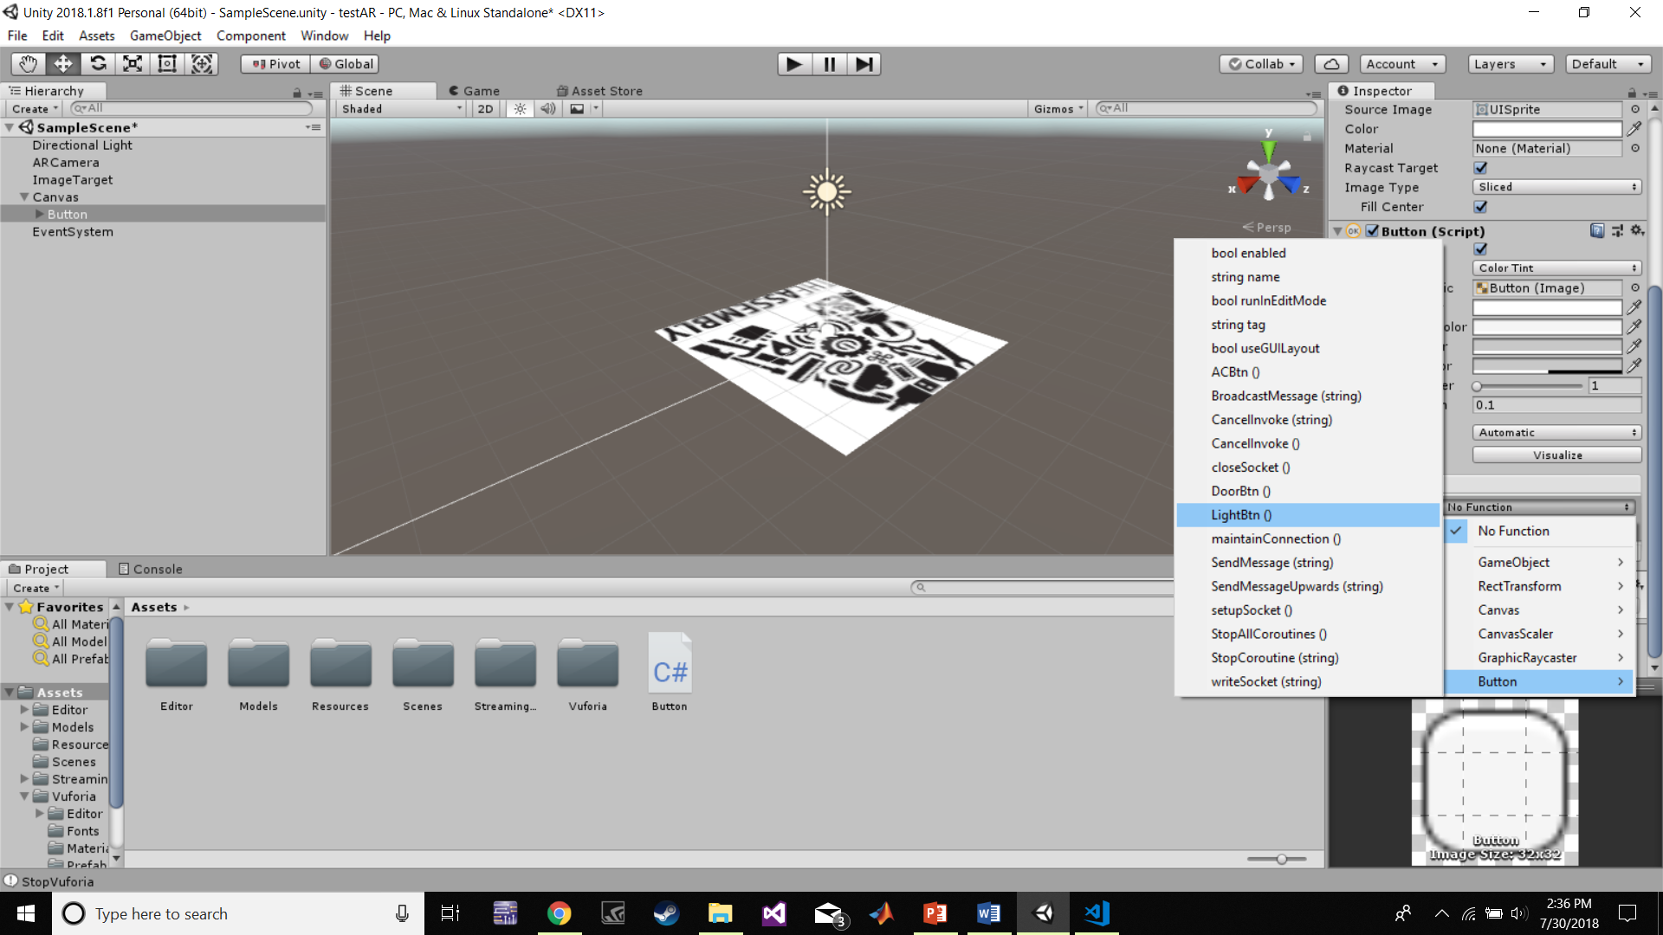
Final Touches

Slide 39
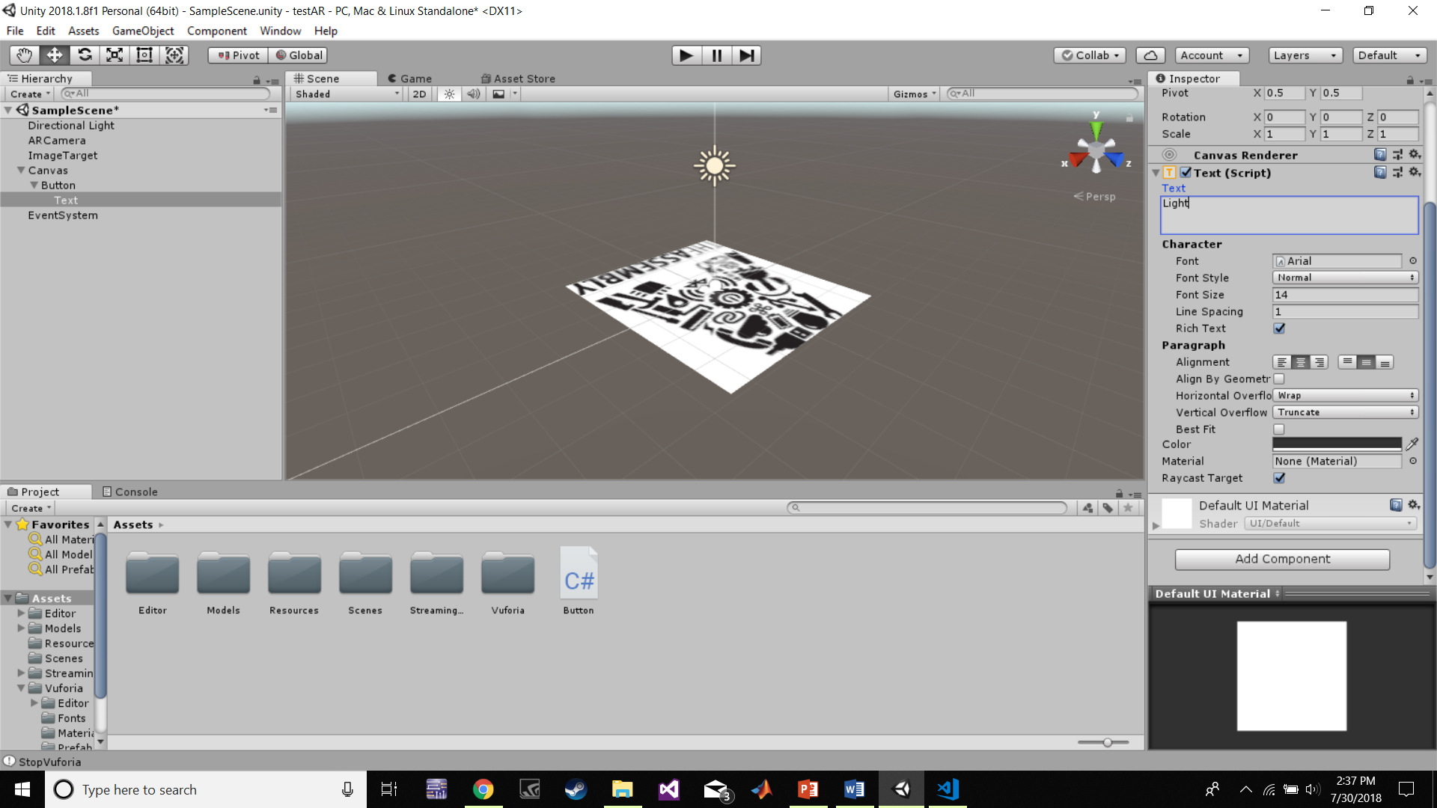
Final Touches

Slide 40

Final Touches

Slide 41
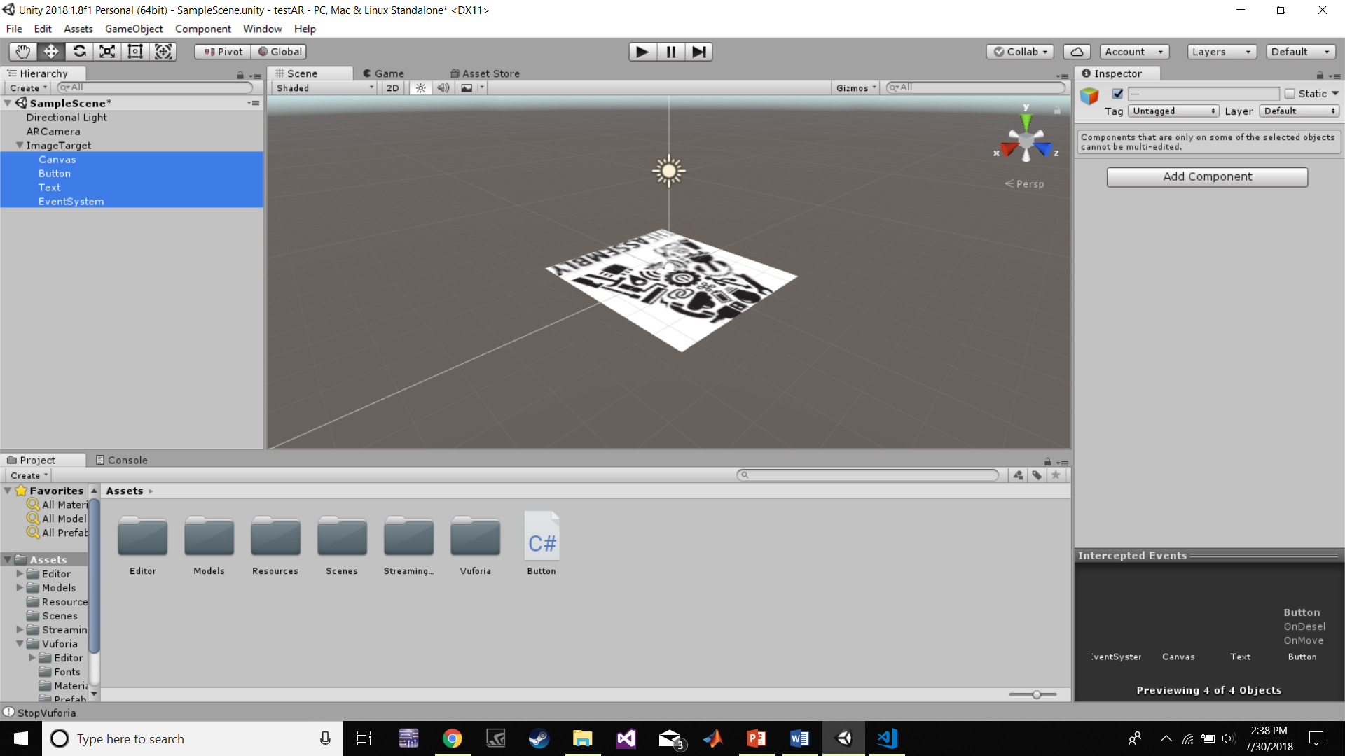
Final Touches

Slide 42
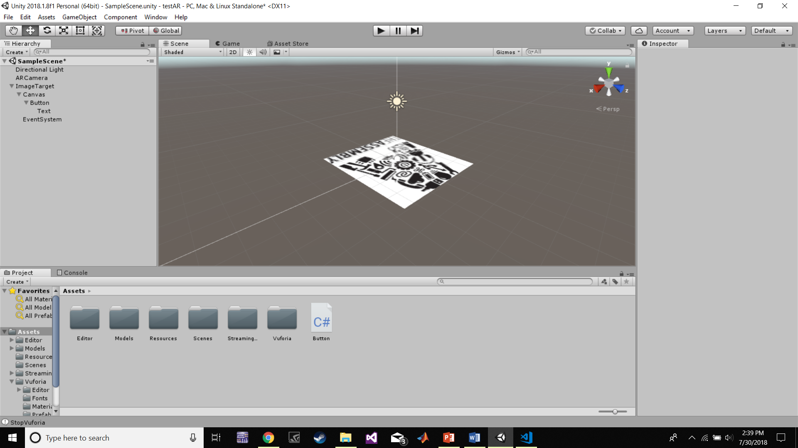
Final Touches

Slide 43
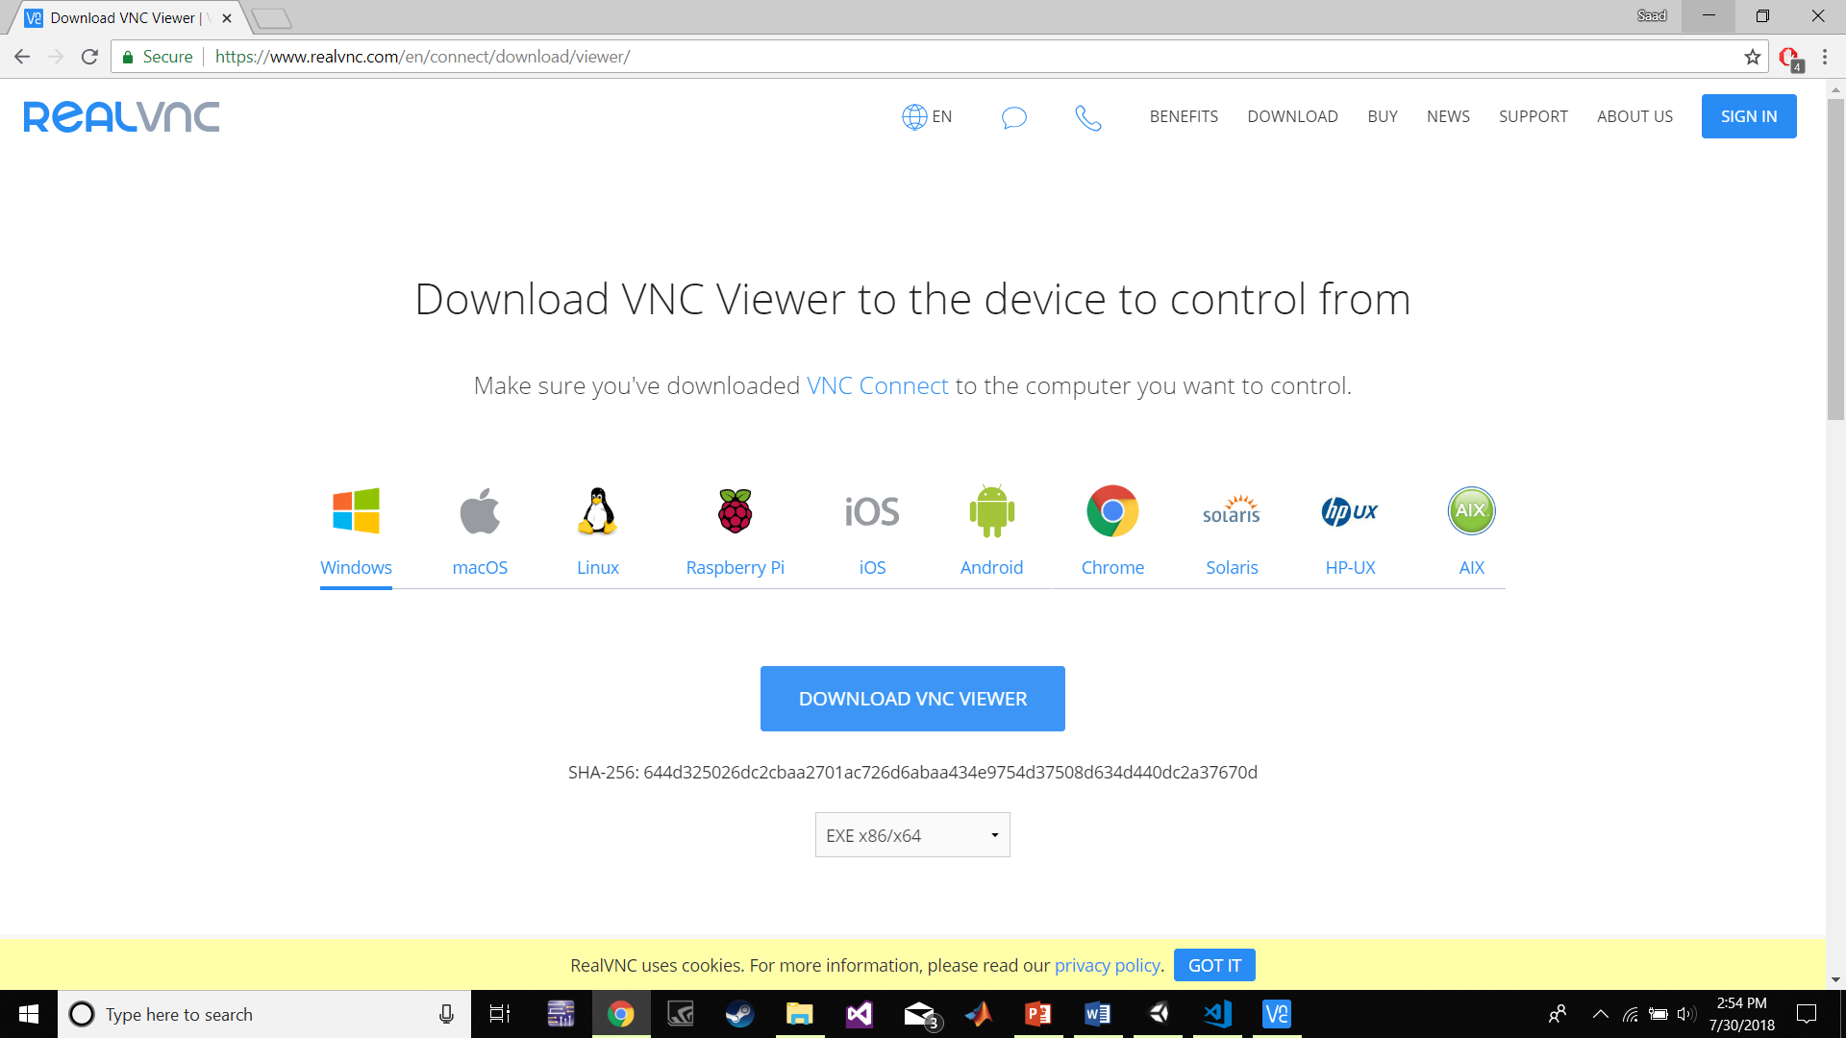
Running

Slide 44
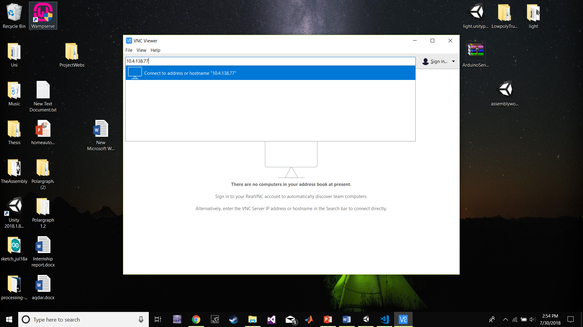
Running

Slide 45
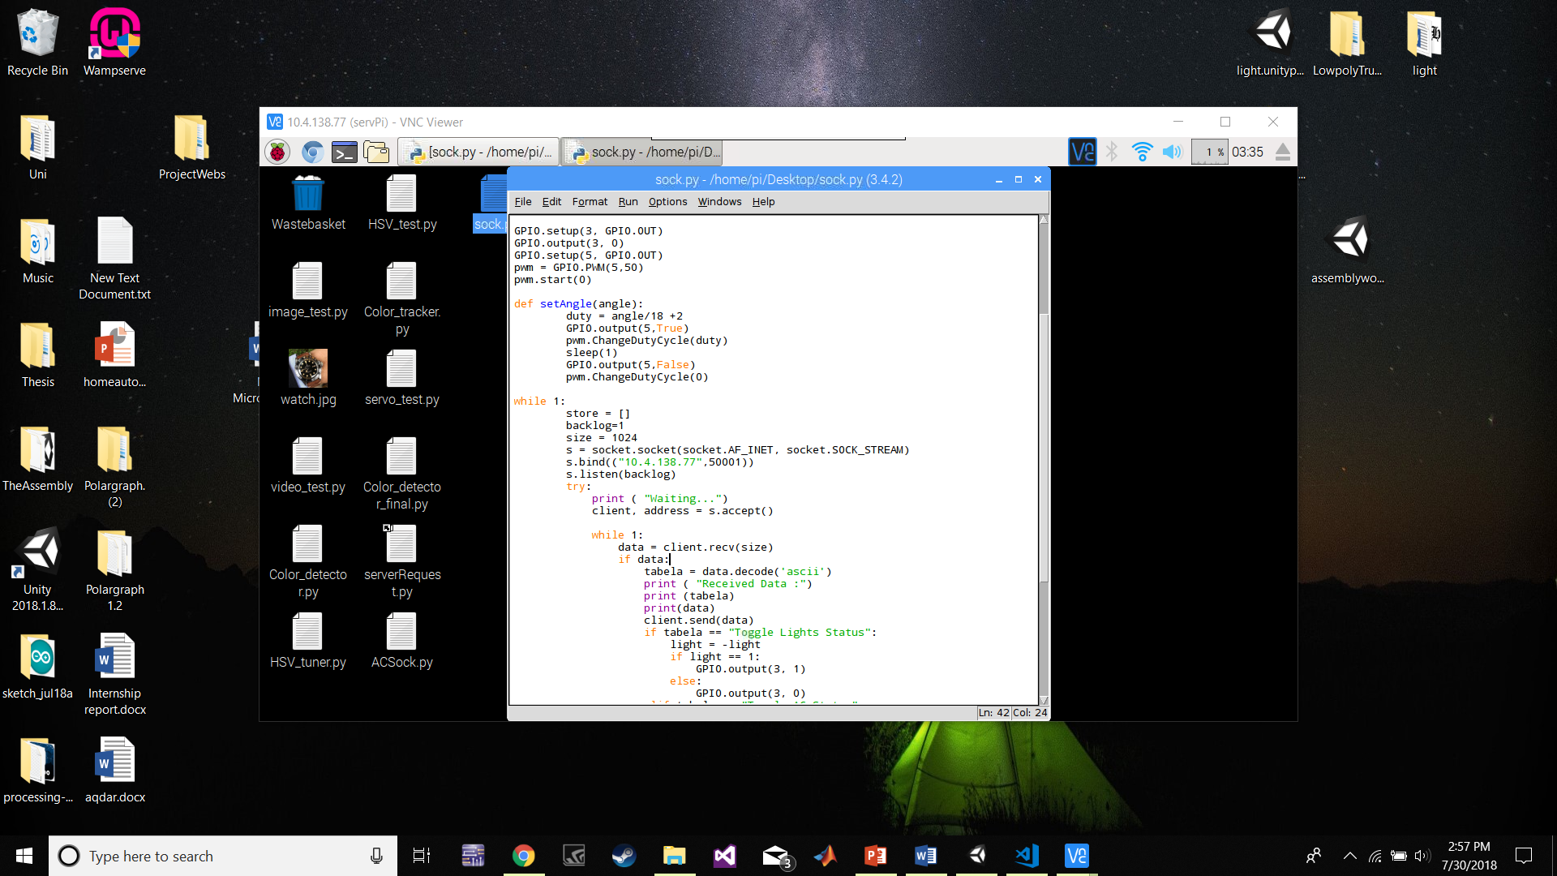
Running

Slide 46
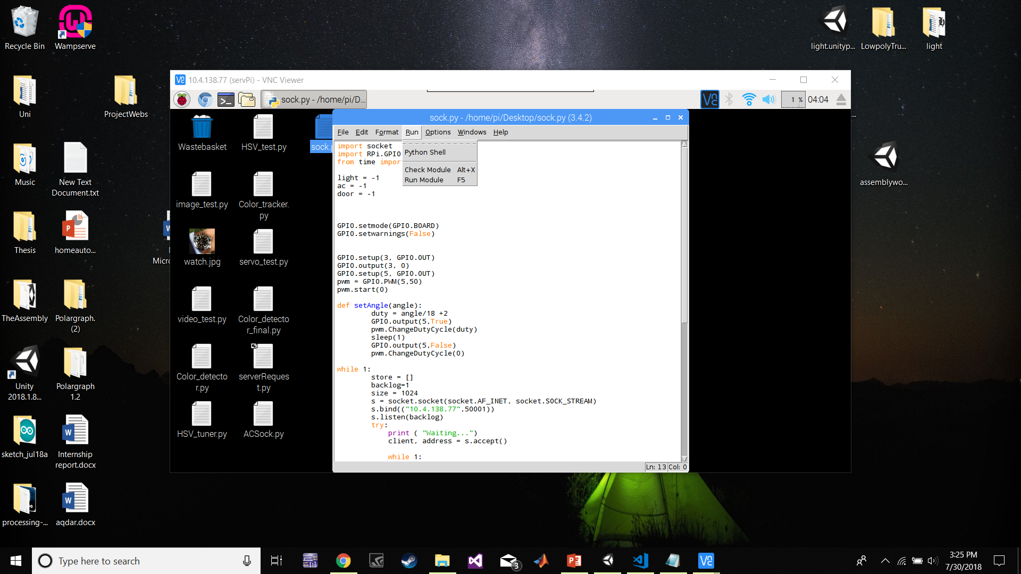
Running

Slide 47
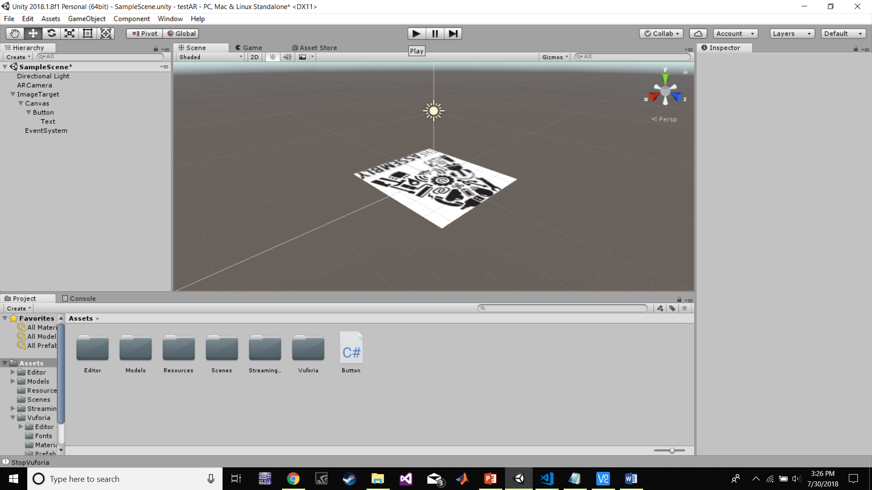
Running

Slide 48
Thank you

